Slide 1
CMSC424: Database Design Module: Database Implementation
Instructor: Amol Deshpande
amol@cs.umd.edu

Slide 2
Database Implementation
Shifting into discussing the internals of a DBMS
How data stored? How queries/transactions executed?
Some of the Topics:
Storage: How is data stored? Important features of the storage devices (RAM, Disks, SSDs, etc)
Tuple Organization: How are tuples laid out
Indexes: How to quickly find specific tuples of interest (e.g., all ‘friends’ of ‘user0’)
Query processing: How to execute different relational operations? How to combine them to execute an SQL query? How to do this in a parallel setting?
Query optimization: How to choose the best way to execute a query?
Transactions: How to support the ACID properties? In a distributed setting?

Slide 3
CMSC424: Database Design Module: Database Implementation
Computing Hardware
Instructor: Amol Deshpande
amol@cs.umd.edu

Slide 4
Computing Hardware
Book Chapters
10, 20 (and some other online resources)
Key topics:
Differences between storage media
Storage hierarchy, Caches, SSDs
Parallel vs Distributed

Slide 5
Storage Options
At various points, data stored in different storage hardware
Memory, Disks, SSDs, Tapes, Cache
Tradeoffs between speed and cost of access
CPU needs the data in memory and cache to operate on it
Volatile vs nonvolatile
Volatile: Loses contents when power switched off
Sequential vs random access
Sequential: read the data contiguously
select * from employee
Random: read the data from anywhere at any time
select * from employee where name like ‘__a__b’

Slide 6
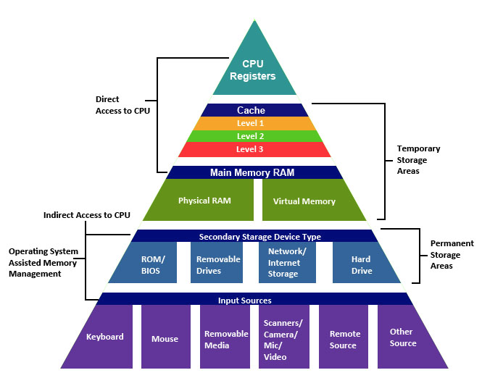
Storage Hierarchy
source: http://cse1.net/recaps/4-memory.html

Slide 7
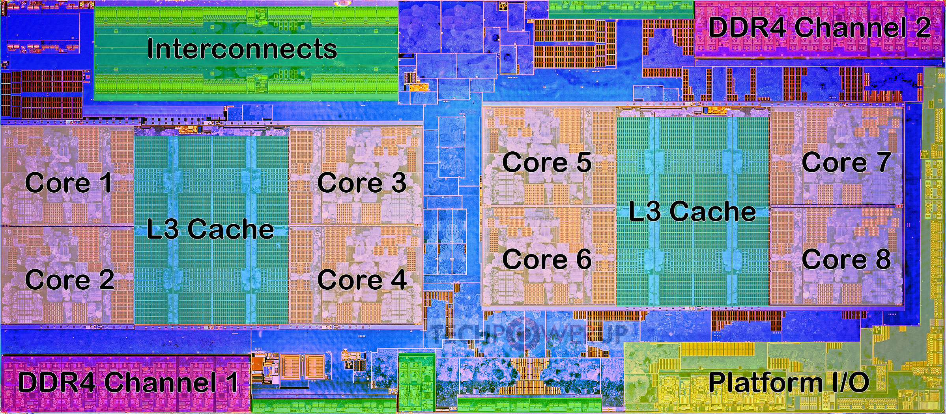
AMD Ryzen CPU Architecture
Die shot overlaid with functional units
https://www.techpowerup.com/review/amd-ryzen-5-1600/3.html

Slide 8
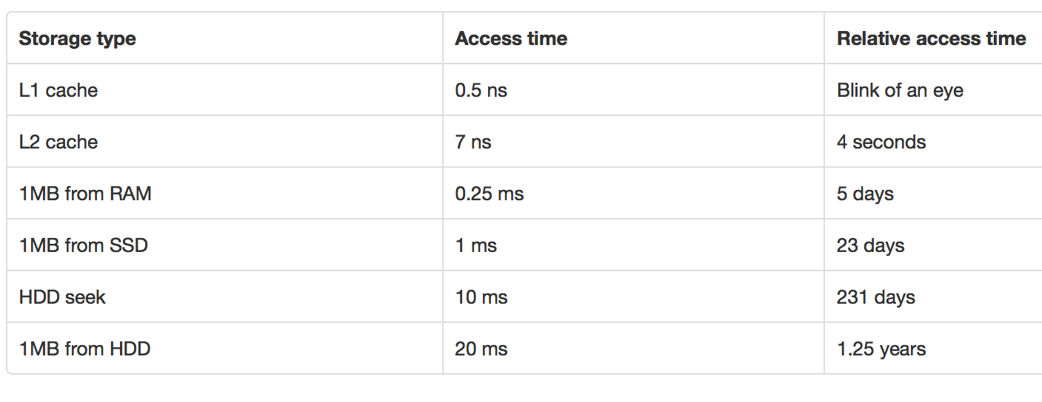
Storage Hierarchy
source: http://cse1.net/recaps/4-memory.html

Slide 9
Storage Options
Primary
e.g. Main memory, cache; typically volatile, fast
Secondary
e.g. Disks; Solid State Drives (SSD); non-volatile
Tertiary
e.g. Tapes; Non-volatile, super cheap, slow
Each storage media has different performance characteristics
Important to understand in order to write systems or optimize queries or tasks

Slide 10
Storage Hierarchy: Cache
Cache
Super fast; volatile; Typically on chip
L1 vs L2 vs L3 caches ???
L1 about 64KB or so; L2 about 1MB; L3 8MB (on chip) to 256MB (off chip)
Huge L3 caches available now-a-days
Becoming more and more important to care about this
Cache misses are expensive
Similar tradeoffs as were seen between main memory and disks

Slide 11
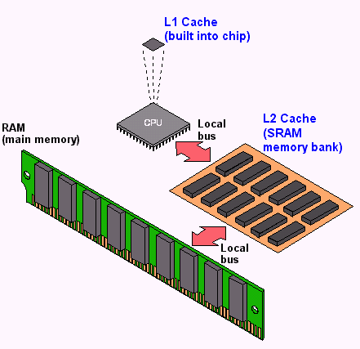
Storage Hierarchy: Cache
source: http://cse1.net/recaps/4-memory.html

Slide 12
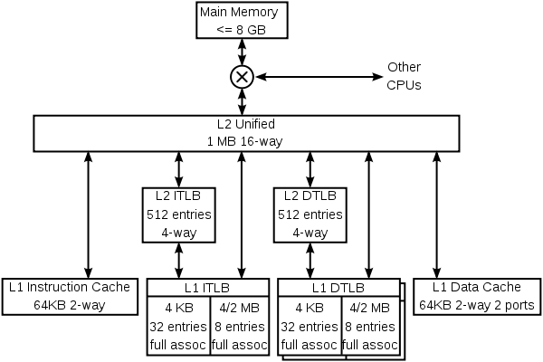
Storage Hierarchy: Cache
K8 core in the AMD Athlon 64 CPU

Slide 13
Storage Hierarchy: Main Memory
Data must be brought from disks/SSDs into Memory (and then into Caches) for the CPU to access it
CPU has no “direct” connection to the disks/SSDs
10s or 100s of ns; Volatile (so will not survive a power failure)
Pretty cheap and dropping: 1GByte < $2-3 today
Main memory databases very common now-a-days
Dramatically changes the tradeoffs
Don’t need to worry about the disks or SSDs as much

Slide 14
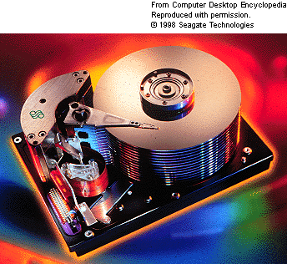
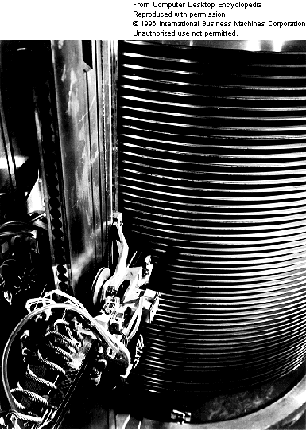
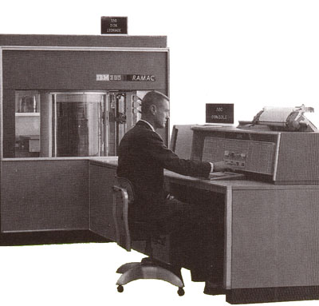
Storage Hierarchy: Magnetic/Hard Disks
Primary ”non-volatile” storage mechanism
1998
SEAGATE
47GB
1956
IBM RAMAC
24” platters
100,000 characters each
5 million characters

Slide 15
Storage Hierarchy: Magnetic/Hard Disks
Primary ”non-volatile” storage mechanism
Accessing a sector
Time to seek to the track (seek time)
average 4 to 10ms
+ Waiting for the sector to get under the head (rotational latency)
average 4 to 11ms
+ Time to transfer the data (transfer time)
very low
About 10ms per access
So if randomly accessed blocks, can only do 100 block transfers
100 x 512bytes = 50 KB/s
Data transfer rates
Rate at which data can be transferred (w/o any seeks)
30-50MB/s to up to 200MB/s (Compare to above)
Seeks are bad !

Slide 16
Hard Disks: Reliability
Mean time to/between failure (MTTF/MTBF):
57 to 136 years
Consider:
1000 new disks
1,200,000 hours of MTTF each
On average, one will fail 1200 hours = 50 days !
Need to assume disk failures are common
Handled today through keeping data in duplicate, or triplicate
If a disk fails, replace with a new disk and copy data over

Slide 17
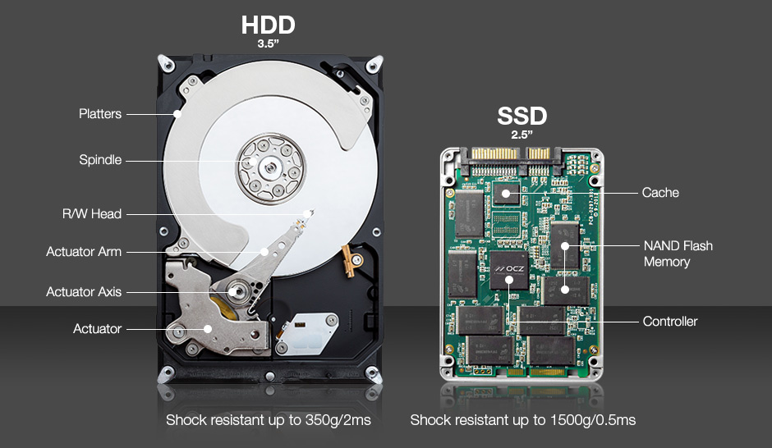
Solid State Drives
Essentially flash that emulates hard disk interfaces
https://blogs.umass.edu/Techbytes/2018/02/23/types-of-ssds-and-which-ones-to-buy/

Slide 18
Solid State Drives
Still support the same “block-oriented” interface
So reads/writes happen in units of blocks
No seeks → Much better random reads performance
Writes are more complicated
Must write an entire block at a time, after first “erasing” it
Limit on how many times you can erase a block
Wear leveling
Distributes writes across the SSD for uniform wearing out
Flash Translation Layer (FTL) takes care of these issues
About a factor of 5-10 more expensive right now

Slide 19
Storage Hierarchy
Optical Storage - CDs/DVDs; Jukeboxes
Used more as backups… Why ?
Very slow to write (if possible at all)
Tape storage
Backups; super-cheap; painful to access
IBM just released a secure tape drive storage solution

Slide 20
Data Storage Options
Hard disks dominant form of storage for a long time
About 10ms per random access ➔ at most 100 random reads per second
vs up to 500 MB/s sequential I/O
Many traditional database design decisions driven by:
Huge volumes of data on disks + Low amounts of memory + Low-speed networks
➔ Communication between disks and memory the main bottleneck
Solid state drives much more common today
No seeks → Much better random reads
Writes require erasing an entire block, and rewriting it
SSDs provide a similar interface of “blocks”

Slide 21
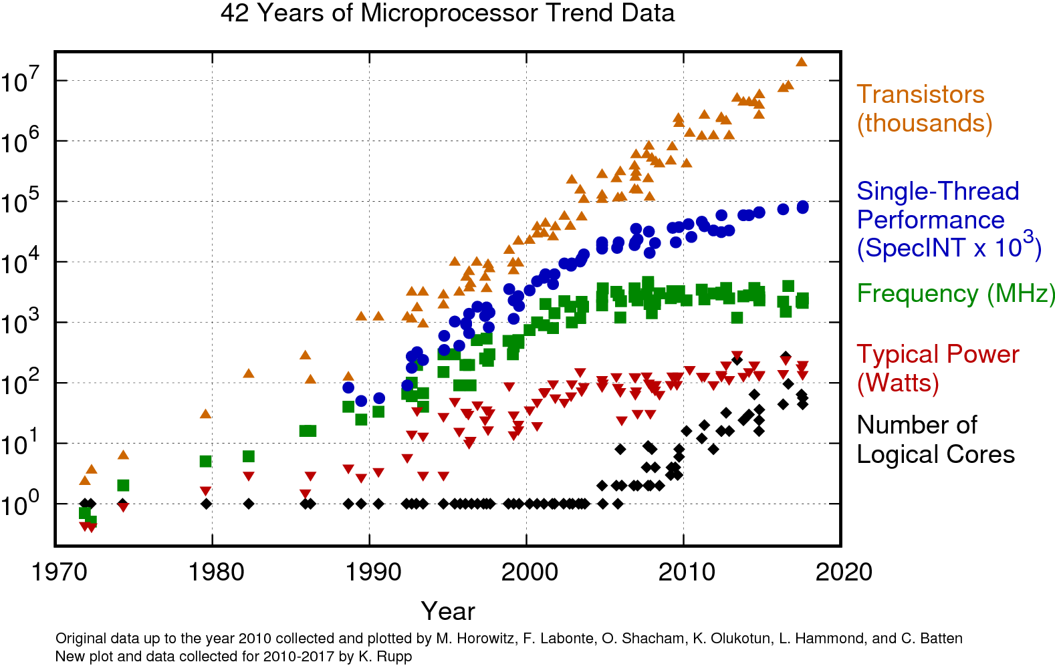
Microprocessors Evolution

Slide 22
AMD Ryzen CPU Architecture
Die shot overlaid with functional units
https://www.techpowerup.com/review/amd-ryzen-5-1600/3.html

Slide 23
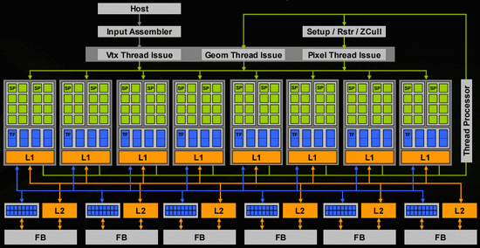
Graphics Processing Units (GPUs)

Slide 24
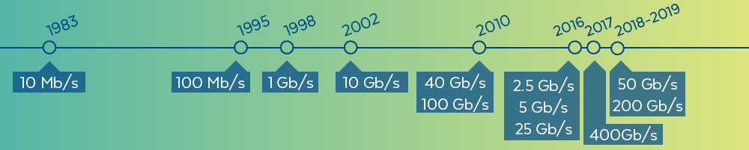
Networks
Faster now to access another computer’s memory (in a data center) than
your own disk.

Slide 25
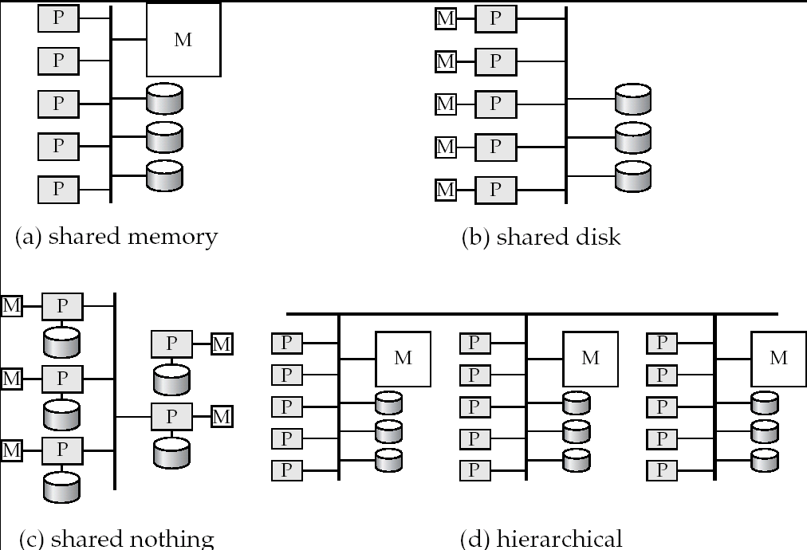
Parallel Architectures

Slide 26
CMSC424: Database Design Module: Database Implementation
Architectures and Tradeoffs
Instructor: Amol Deshpande
amol@umd.edu

Slide 27
Database Architectures
CPU
Multi-core CPUs and GPUs
CPU
Single-core CPU
Small caches
Caches
Large enough to matter
Memory
Limited memory
Memory
Enough to store most of the data
Hard Disk
Most of the data on the disk
SSDs
Used as a backing store (since memory is volatile)

Slide 28
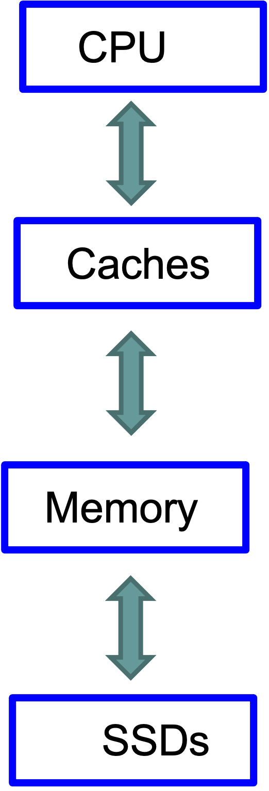
Database Architectures
Very Fast Interconnects

Slide 29
What we will cover
Hard to cover all different compute configurations
We will cover some of the key techniques developed for different environments
Storage formats that are used in different settings
Indexing data structures for disk-resident data, as well as memory
etc..
We will try keep as much of the discussion general as possible
Query processing and optimization
We have already covered some of the parallel techniques
Transaction processing discussion relatively abstract

Slide 30
CMSC424: Database Design Module: Database Implementation
Storage Representations
Instructor: Amol Deshpande
amol@umd.edu

Slide 31
Storage Representations
Book Chapters
10.5, 10.6
13.6 (column-oriented storage)
Key topics:
Different ways the tuples are laid out in disk/memory
Pros and cons of the different approaches

Slide 32
Storage Representations
Hard disks/SSDs/Memory are all typically divided into “blocks” or “pages”
Traditionally 4K or 8K
Data movement usually in units of blocks/pages
i.e., we usually move one or more blocks from disk to memory
Can’t move just a small part of a block
Memory-to-Cache is in smaller units
Called “cache lines” -- 64 bytes or 128 bytes
Usually each memory page is divided into multiple cache lines

Slide 33
Storage Representations
Cache Line
Memory page
Disk block
“Buffer Manager” responsible for moving
things back and forth

Slide 34
Storage Representations
Hard disks/SSDs/Memory are all typically divided into “blocks” or “pages”
Traditionally 4K or 8K
Data movement usually in units of blocks/pages
i.e., we usually move one or more blocks from disk to memory
Can’t move just a small part of a block
Memory-to-Cache is in smaller units
Called “cache lines” -- 64 bytes or 128 bytes
Usually each memory page is divided into multiple cache lines
➔ Important to allocate tuples to blocks carefully
Want to keep data that is accessed together in the same block
Fetching 4KB of data, and only using 100 bytes not a good idea
➔ Even within a block, how data is laid out matters for cache performance

Slide 35
Additional Considerations
Need to support efficient search/updates
e.g., may wish to keep the data sorted → inserts/deletes are tricky
May wish to build indexes/search trees on top of the blocks
Want to avoid serialization/deserialization overhead ➔ ideal to use the same format in memory as on disk
So after loading a block from disk to memory, the execution engine can immediately start reading/writing it
For hard disks: sequential reads are much much better than random block reads
So prefer to arrange data so we do few random reads
For SSDs, “writes” needs to be done carefully -- updating a single byte on a page usually not a good idea

Slide 36
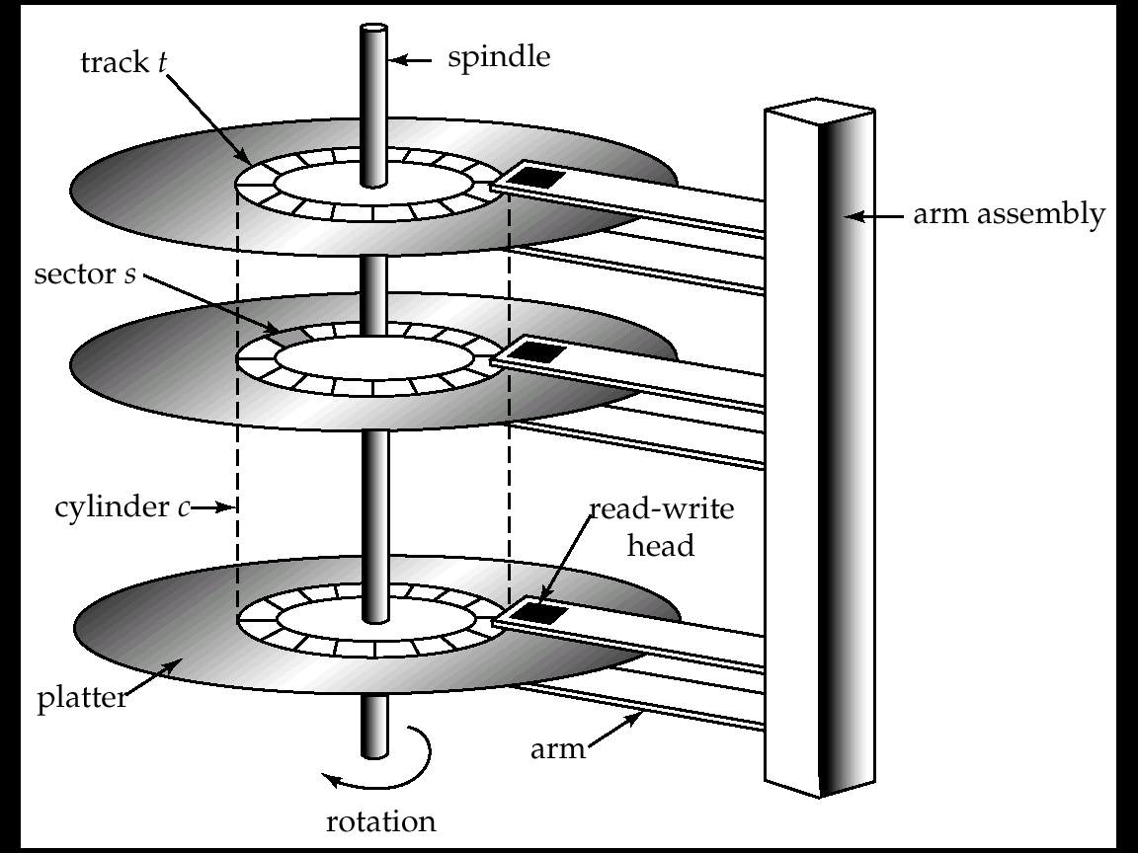
Mapping Tuples to Blocks
Very important implications on performance
Quite a few different ways to do this
Similar issues even if not using disks as the primary storage
?

Slide 37
Mapping Tuples to Blocks
Requirements and Performance Goals:
Allow insertion/deletions of tuples/records in relations
Fetch a particular record (specified by record id)
Find all tuples that match a condition (say SSN = 123) ?
Fetch all tuples from a specific relation (scans)
Faster if they are all sequential/in contiguous blocks
Allow building of “indexes”
Auxiliary data structures maintained on disks and in memory for faster retrieval
And so on…

Slide 38
Aside: File System or Not
Option 1: Use OS File System
File systems are a standard abstraction provided by Operating Systems (OS) for managing data
Major Con: Databases don’t have as much control over the physical placement anymore --- OS controls that
E.g., Say DBMS maps a relation to a “file”
No guarantee that the file will be “contiguous” on the disk
OS may spread it across the disk, and won’t even tell the DBMS
Option 2: DBMS directly works with the disk or uses a lightweight/custom OS
Increasingly uncommon – most DBMSs today run on top of OSes (e.g., PostgreSQL on your laptop, or on linux VMs in the cloud, or on a distributed HDFS)

Slide 39
Through a File System
Option 1: Allocate a single “file” on the disk, and treat it as a contiguous sequence of blocks
This is what PostgreSQL does
The blocks may not actually be contiguous on disk
Option 2: A different file per relation
Some of the simpler DBMS use this approach
Either way: we have a set of relations mapped to a set of blocks on disk

Slide 40
Assumptions for Now
Each relation stored separately on a separate set of blocks
Assumed to be contiguous
Each “index” maintained in a separate set of blocks
Assumed to be contiguous
Disk block
instructor
student
B+-tree index for instructor
Some extra space for new tuples

Slide 41
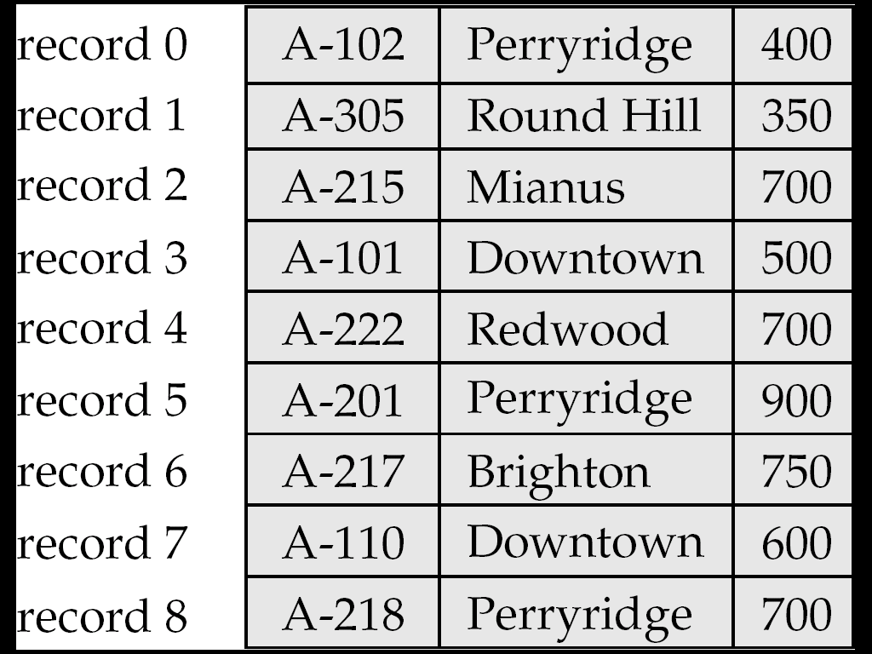
Within block: Fixed Length Records
n = number of bytes per record
Store record i at position:
n * (i – 1)
Records may cross blocks
Not desirable
Stagger so that that doesn’t happen
Inserting a tuple ?
Depends on the policy used
One option: Simply append at the end of the record
Deletions ?
Option 1: Rearrange
Option 2: Keep a free list and use for next insert

Slide 42
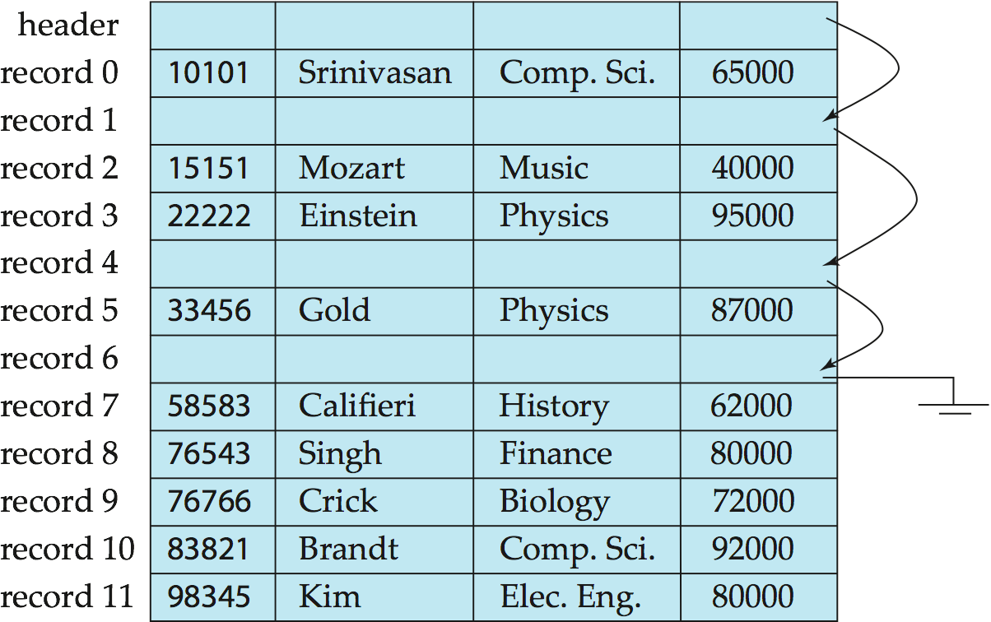
Within block: Fixed Length Records
Deleting: using “free lists”

Slide 43
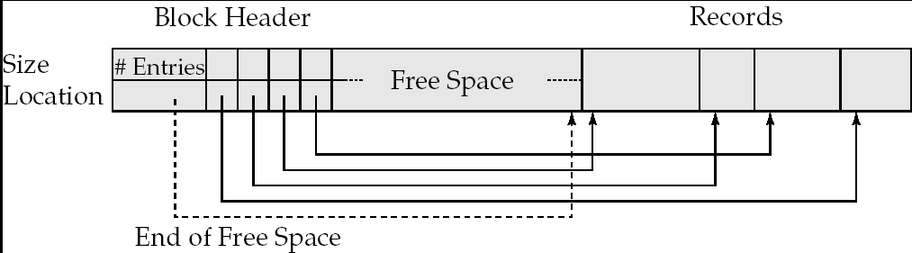
Within block: Variable-length Records
Slotted page/block structure
Indirection:
The records may move inside the page, but the outside world is oblivious to it
Why ?
The headers are used as a indirection mechanism
Record ID 1000 is the 5th entry in the page number X

Slide 44
Within block: Cache-optimized Structure
Row-wise storage (called NSM here) not optimized for caches
Most of the data brought into cache not useful
➔ Lot of “cache misses”

Slide 45
Within block: Cache-optimized Structure
Instead, lay out the data column-wise inside a block/page (called PAX below)

Slide 46
Across Blocks of a Relation
Which block should a record go to ?
Anywhere ?
How to search for “SSN = 123” ?
Called “heap” organization
Sorted by SSN ?
Called “sequential” organization
Keeping it sorted would be painful
How would you search ?
Based on a “hash” key
Called “hashing” organization
Store the record with SSN = x in the block number x%1000
Why ?

Slide 47
Across Blocks: Sequential File Organization
Keep sorted by some search key
Insertion
Find the block in which the tuple should be
If there is free space, insert it
Otherwise, must create overflow pages
Deletions
Delete and keep the free space
Databases tend to be insert heavy, so free space gets used fast
Can become fragmented
Must reorganize once in a while

Slide 48
Across Blocks: Sequential File Organization
What if I want to find a particular record by value ?
Account info for SSN = 123
Binary search
Takes log(n) number of disk accesses
Random accesses
Too much
n = 1,000,000,000 -- log(n) = 30
Recall each random access approx 10 ms
300 ms to find just one account information
< 4 requests satisfied per second
Indexes – later

Slide 49
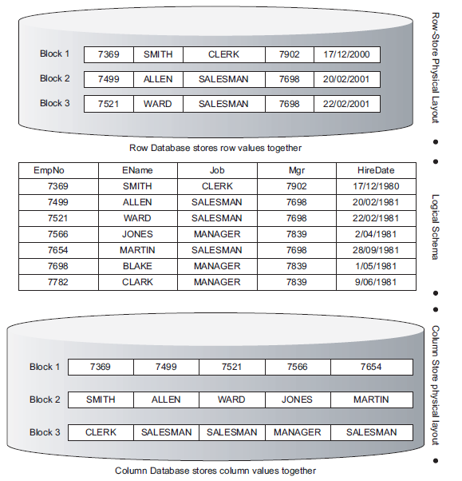
Column-oriented Storage

Slide 50
Column-oriented Storage
Benefits
Reduced I/O -- only fetch the relevant queries
Especially useful when a table has say 50 columns and the query only wants 2-3 of those
Improved CPU Cache Performance
Improved compression
Each block contains similar data -- so more easily compressed
Vector processing
Can better utilize modern CPUs

Slide 51
Column-oriented Storage
Drawbacks
Extra cost to reconstruct full tuples
To support queries like: “select * from R”
A single tuple is spread out across many blocks
Tuple deletions/updates much harder
Cost of decompression (if compression being used)
Widely used today in data warehouses
Ideal use case -- fewer/batched updates, and very large and wide tables
Similar ideas also used in systems like pandas

Slide 52
Columnar “file” representations
Scenario: “CSV”-like files stored in data lakes or file-systems
Also JSON collections (e.g., “prize.json” from Assignment 4) not being stored in a database like MongoDB
Modern data lakes have thousands to millions of such files, and want to support SQL over them (e.g., through Spark)
Keeping as “text” files not efficient
Storage overhead -- binary compressed representations much smaller
Parsing text is expensive
Same row-vs-column representation issues
Since these are basically relations, often only need to read a few columns

Slide 53
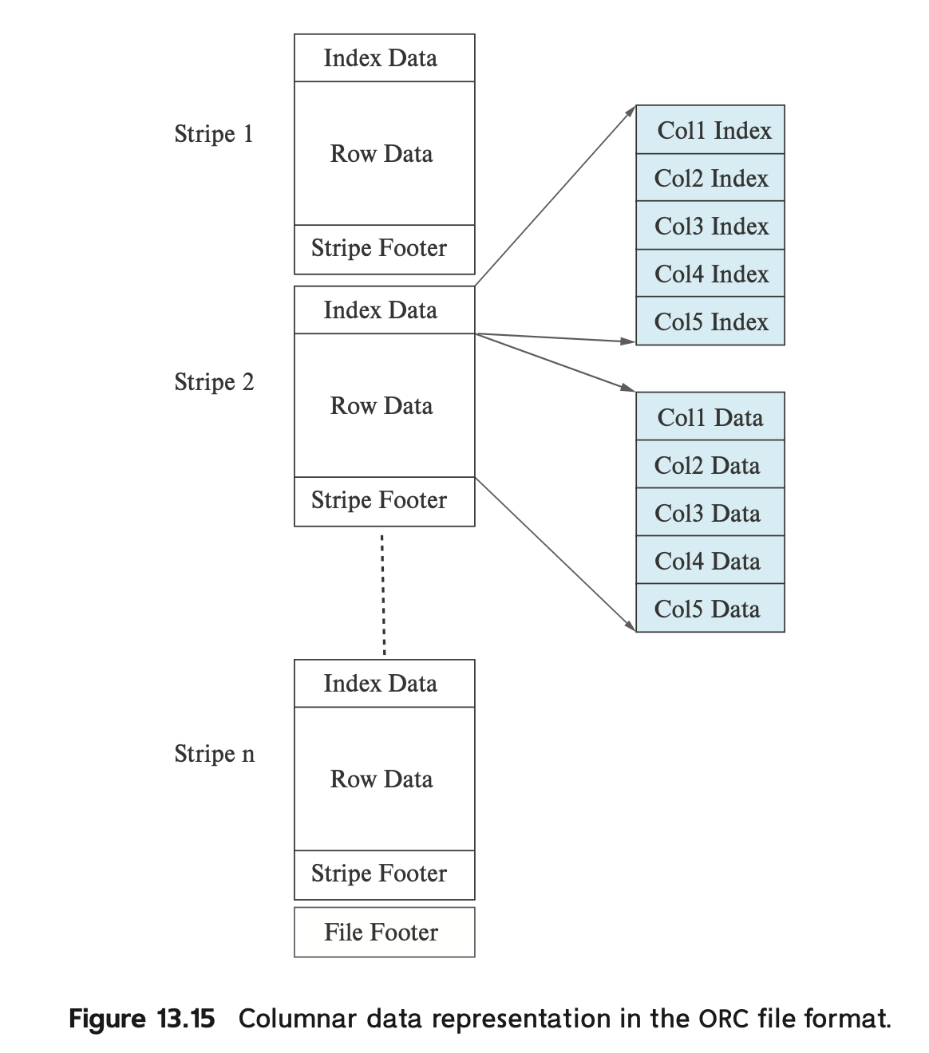
Columnar “file” representations
Several formats developed over the years
Parquet probably most popular right now
ORC another one
Mostly “columnar” and designed to be primarily read-only
Usually compressed formats
Each ”chunk” of column data compressed

Slide 54
Summary
Storage layouts an important consideration
Given the data sizes we see in practice
Primary decision: row vs column representation
Row representations better for scenarios where updates more common
Column representations much better for data warehouses or data lakes (large data sizes + batched updates.+ complex queries)
Hybrid representations tried, but haven’t really worked out
Many other secondary considerations
E.g, sort orders/assignment of tuples to blocks
How to handle inserts/deletions
Cache performance and vectorized execution
Similar issues for non-relational data (e.g., document stores)

Slide 55
CMSC424: Database Design Module: Database Implementation
Indexes; B+-Trees
Instructor: Amol Deshpande
amol@cs.umd.edu

Slide 56
Indexes Overview
Book Chapters
11.1, 11.2, 11.3 (B+-tree)
Key topics:
How an “index” helps efficiently find tuples that satisfy a condition?
What are key characteristics of indexes?
B+-Tree Indexes

Slide 57
Index
A data structure for efficient search through large databases
Two key ideas:
The records are mapped to the disk blocks in specific ways
Sorted, or hash-based
Auxiliary data structures are maintained that allow quick search
Search key:
Attribute or set of attributes used to look up records
E.g. SSN for a persons table
Two types of indexes
Ordered indexes
Hash-based indexes
Think library index/catalogue

Slide 58


Slide 59
Ordered Indexes
Primary index
The relation is sorted on the search key of the index
Secondary index
It is not
Can have only one primary index on a relation
^{Index}
^{Relation}

Slide 60
Primary Sparse Index
Every key doesn’t have to appear in the index
Allows for very small indexes
Better chance of fitting in memory
Tradeoff: Must access the relation file even if the record is not present

Slide 61
Primary Dense Index
Every key must appear in the index
Index becomes pretty large, but can often avoid having to go to the relation
E.g., select * from instructor where ID = 10000
Not found in the index, so can return immediately

Slide 62
Secondary Index
Relation sorted on ID
But we want an index on salary
Must be dense
Every search key must appear in the index

Slide 63
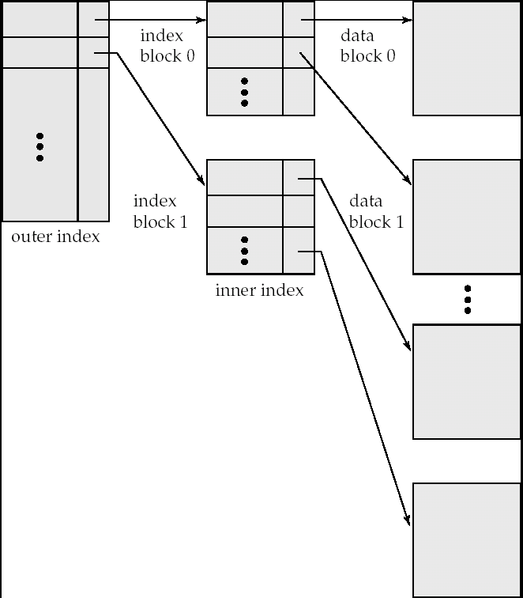
Multi-level Indexes
What if the index itself is too big for memory ?
Relation size = n = 1,000,000,000
Block size = 100 tuples per block
So, number of pages = 10,000,000
Keeping one entry per page takes too much space
Solution
Build an index on the index itself

Slide 64
B+-Tree Indexes
Very widely used in relational database systems
Optimized for hard disks
Not the first choice today
Ordered indexes
Allow efficient “range” searches
Balanced and small height

Slide 65
B+-Tree Index
Index Disk Blocks

Slide 66
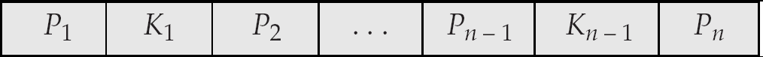
B⁺-Tree Node Structure
Typical node
K_{i} are the search-key values
P_{i} are pointers to children (for non-leaf nodes) or pointers to records or buckets of records (for leaf nodes).
The search-keys in a node are ordered
K₁ < K₂ < K₃ < . . . < K_{n–1}

Slide 67
Properties of B+-Trees
It is balanced
Every path from the root to a leaf is same length
Leaf nodes (at the bottom)
P1 contains the pointers to tuple(s) with key K1
…
Pn is a pointer to the next leaf node
Must contain at least n/2 entries

Slide 68
Properties
Interior nodes
All tuples in the subtree pointed to by P1, have search key < K1
To find a tuple with key K1’ < K1, follow P1
…
Finally, search keys in the tuples contained in the subtree pointed to by Pn, are all larger than Kn-1
Must contain at least n/2 entries (unless root)

Slide 69
B+-Trees - Searching
How to search ?
Follow the pointers
Logarithmic
log_{B/2}(N), where B = Number of entries per block
B is also called the order of the B+-Tree Index
Typically 100 or so
If a relation contains1,000,000,000 entries, takes only 4 random accesses
The top levels are typically in memory
So only requires 1 or 2 random accesses per request

Slide 70
Example B+-Tree Index

Slide 71
Example B+-Tree Index
If this were a “primary” index, then not all ”keys” are present in the index

Slide 72
B+-Trees - Updates
When inserting or deleting, two properties need to be maintained
Each block remains at least half-full (except the root which may be less than half-full)
The tree must remain balanced
When inserting, this may result in a new root being created
When deleting, this may result in reducing the height of the tree by one

Slide 73
B⁺-Trees: Insertion

Slide 74
B⁺-Trees: Insertion

Slide 75
Examples of B⁺-Tree Deletion
Deleting “Katz” – No issues
Deleting “Gold” – Just delete from the leaf
Gold can stay in the “interior” node – no need to delete it
The purpose of the search keys in the interior nodes is to “direct” searches

Slide 76
Examples of B⁺-Tree Deletion
Before and after deleting “Singh” and “Wu”

Slide 77
Examples of B⁺-Tree Deletion
Deletion of “Gold”
Rightmost two leaves merged into a single one: (Katz, Kim, Mozart)
Need to remove a pointer from parent node (Kim), which also becomes underful and merged with its sibling (Califieri, Einstein) ➔ New root

Slide 78
B+-Trees: Summary
Main benefit: reduce the number of “block” accesses on a disk when searching for one or few tuples
Consider a relation with 1,000,000 blocks (= 4GB assuming 4k blocks)
Sequential scan to find a tuple would take: 4GB/200MB/s = 20s
Assuming we are not doing any seeks
Using a B+-tree would take 4-5 random accesses = 40-50 ms
Today, LSM Trees (Log-structured-merge trees) are considered a better idea in most use cases
More compact, and better write performance

Slide 79
CMSC424: Database Design Module: File Organization and Indexes
Hash Indexes; Miscellaneous
Instructor: Amol Deshpande
amol@cs.umd.edu

Slide 80
Hash Indexes
Book Chapters
11.6, 11.7 (at a high level), 11.4.1, 11.4.5, 11.5, 11.9 (briefly)
Key topics:
Hash-based file organization
Static hashing-based indexes
Handling of bucket overflows
Log-structured Merge Trees
Multi-key indexes, Bitmap indexes, R-Trees

Slide 81
Hash-based File Organization
Store record with search key k
in block number h(k)
e.g. for a person file,
h(SSN) = SSN % 4
Blocks called “buckets”
What if the block becomes full ?
Overflow pages
Uniformity property:
Don’t want all tuples to map to
the same bucket
h(SSN) = SSN % 2 would be bad
Hash functions should also be random
Should handle different real datasets
(1000, “A”,…)
(200, “B”,…)
(4044, “C”, …)
Block 0
(401, “Ax”,…)
(21, “Bx”,…)
Block 1
Buckets
(1002, “Ay”,…)
(10, “By”,…)
Block 2
(1003, “Az”,…)
(35, “Bz”,…)
Block 3

Slide 82
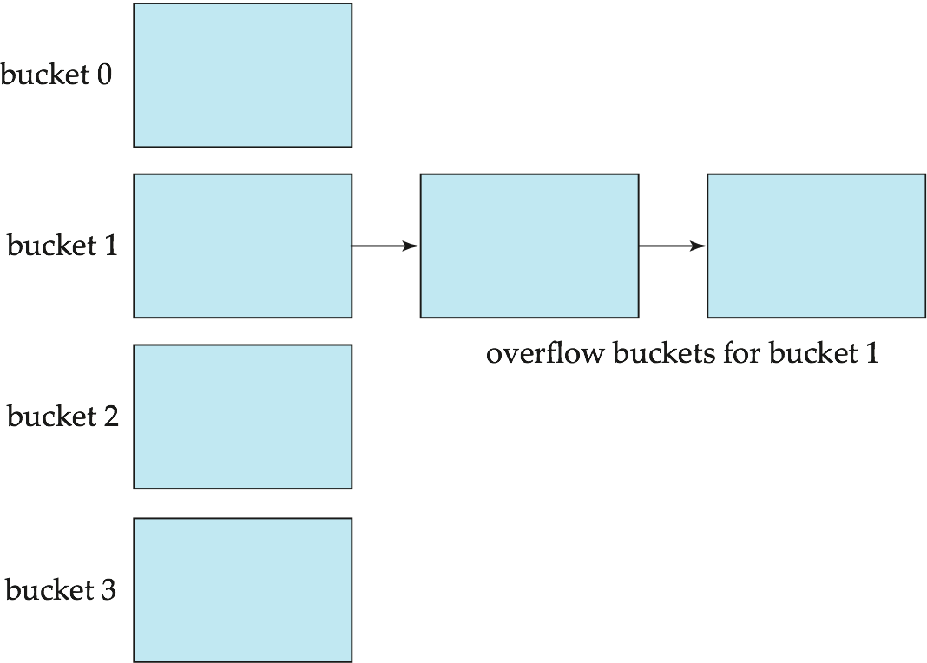
Overflow Pages
Overflow chaining – the overflow buckets of a given bucket are chained together in a linked list.
Above scheme is called closed hashing.
An alternative, called open hashing, which does not use overflow buckets, is not suitable for database applications.

Slide 83
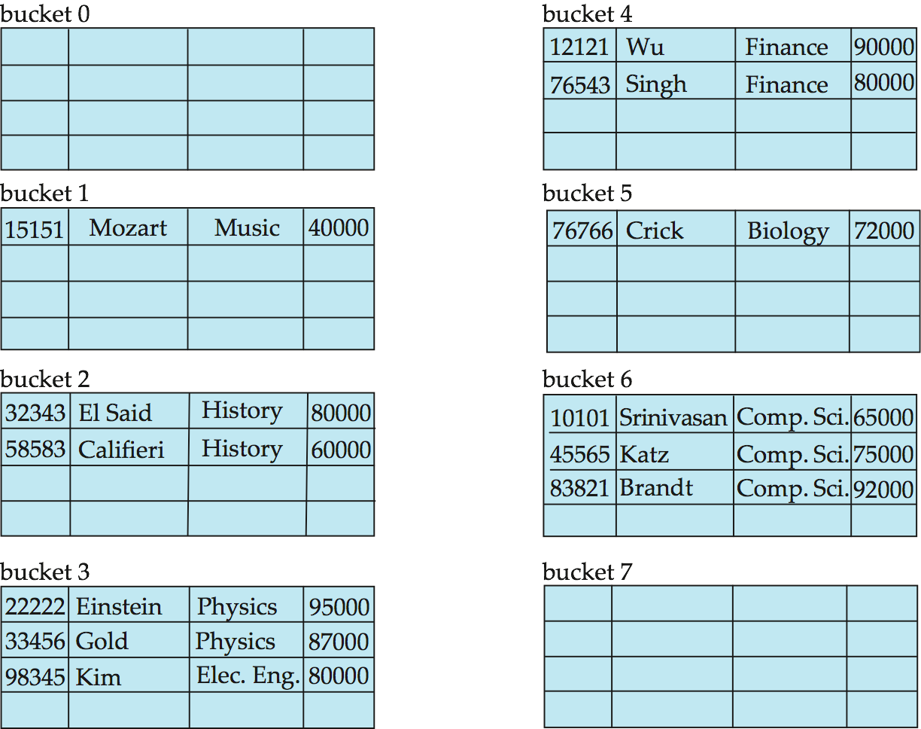
Hash-based File Organization
Hashed on “branch-name”
Hash function:
a = 1, b = 2, .., z = 26
h(abz)
= (1 + 2 + 26) % 10
= 9

Slide 84
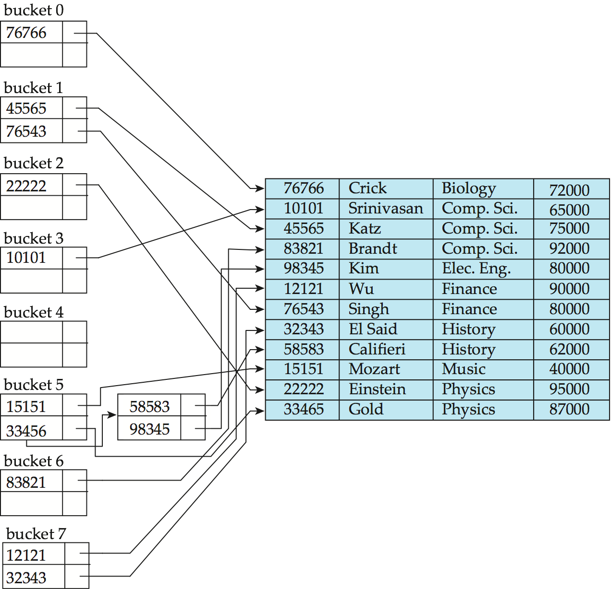
Hash Indexes
Extends the basic idea
Search:
Find the block with
search key
Follow the pointer
Range search ?
a < X < b ?
hash index on instructor, on attribute ID

Slide 85
Hash Indexes
Very fast search on equality
Can’t search for “ranges” at all
Must scan the file
Inserts/Deletes
Overflow pages can degrade the performance
Can do periodic reorganization (by modifying hash functions)
A better approach is to use “dynamic hashing”
Allow use of a hash function that can be modified
e.g., Extendable Hashing, or Linear Hashing

Slide 86
Comparison of Ordered Indexing and Hashing
Cost of periodic re-organization
Relative frequency of insertions and deletions
Is it desirable to optimize average access time at the expense of worst-case access time?
Expected type of queries:
Hashing is generally better at retrieving records having a specified value of the key.
If range queries are common, ordered indices are to be preferred
Hashing very common in distributed settings (e.g., in key-value stores)

Slide 87
Log-structured Merge Trees
Very widely used today, in most modern systems
RocksDB, Cassandra, LevelDB, InfluxDB, Bigtable, …
Key insight:
B+-trees/Hash index etc., require ”in-place” random updates
See the reorganizations that we had to do in the earlier examples
Not a good idea as the gap between random and sequential increases
Also, not a good idea for SSDs which don’t like small writes
Instead
Keep all the data sorted in memory and build red/black tree or binary tree on it
As you run out of memory, write out the sorted “run” to disk and never modify it again (except see below)
When “searching”, you have to search all of ”runs” -- so periodically compact them to reduce the number of runs

Slide 88
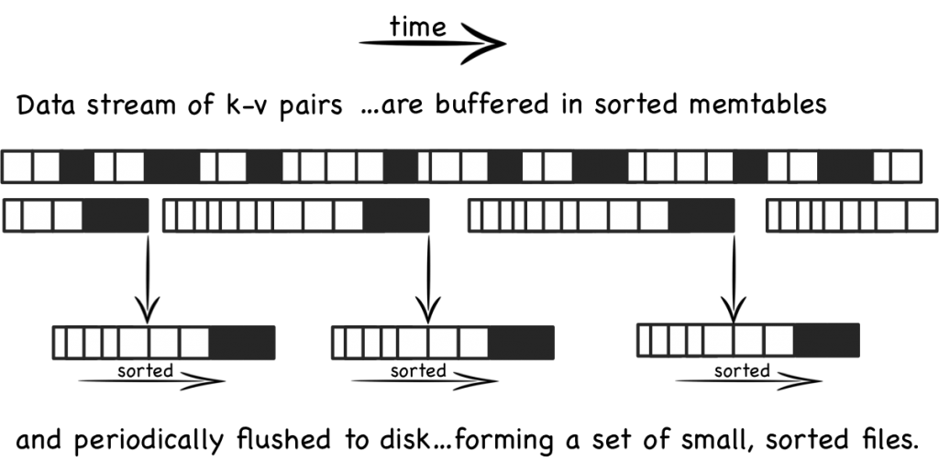
Log-structured Merge Trees
http://www.benstopford.com/2015/02/14/log-structured-merge-trees/
Notes:
http://www.benstopford.com/2015/02/14/log-structured-merge-trees/

Slide 89
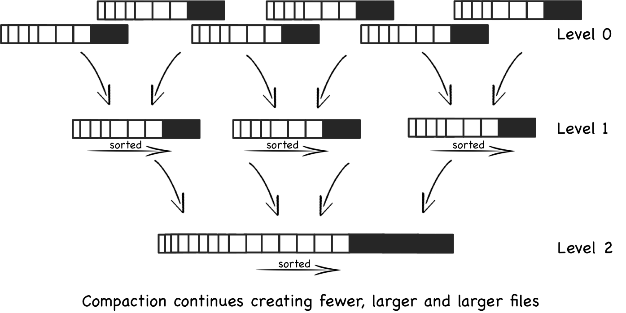
Log-structured Merge Trees
http://www.benstopford.com/2015/02/14/log-structured-merge-trees/
Notes:
http://www.benstopford.com/2015/02/14/log-structured-merge-trees/

Slide 90
Log-structured Merge Trees
Benefits:
Large sequential writes
Compaction is done in a batched fashion and exploits the sorted nature → very fast and sequential writes as well
Drawbacks:
Searching is expensive
Same “key” is present in many different files
Can use “bloom filters” to reduce the number of files touched
Read up if interested

Slide 91
Multiple-Key Access
select ID
from instructor
where dept_name = “Finance” and salary = 80000
Possible strategies for processing query using indices on single attributes:
Use index on dept_name to find instructors with department name Finance; test salary = 80000
Use index on salary to find instructors with a salary of $80000; test dept_name = “Finance”.
Use dept_name index to find pointers to all records pertaining to the “Finance” department. Similarly use index on salary. Take intersection of both sets of pointers obtained.
Called “INDEX-ANDING”

Slide 92
Indices on Multiple Keys
Composite search keys are search keys containing more than one attribute
E.g. (dept_name, salary)
Lexicographic ordering: (a₁, a₂) < (b₁, b₂) if either
a₁ < b₁, or
a₁=b₁ and a₂ < b₂
Ideal for something like:
where dept_name = “Finance” and salary = 80000
Can also efficiently handle where dept_name = “Finance” and salary < 80000
But cannot efficiently handle where dept_name < “Finance” and balance = 80000

Slide 93
Bitmap Indices
Specialized indexes used in data warehouses
Assume records numbered sequentially from 0
Given a number n it must be easy to retrieve record n
Particularly easy if records are of fixed size
Best for attributes that with a small domain
E.g., gender, country, state, …
E.g., income-level (income broken up into a small number of levels such as 0-9999, 10000-19999, 20000-50000, 50000- infinity)
A bitmap is simply an array of bits

Slide 94
Bitmap Indices (Cont.)
Bitmap index on an attribute has one bitmap for each value of the attribute
Bitmap has as many bits as records
Keeps track of whether a record has that value for the attr

Slide 95
Bitmap Indices (Cont.)
Not particularly useful for single attribute queries
But consider a query: gender = m and income_level = L1
Retrieve individual bitmaps for those two
Do an AND to find all records that satisfy both conditions
Retrieve only those records
Can also be used for gender = m or income_level = L1
Really useful when queries have many predicates, and relations are large (i.e., a data warehouse)
Updating bitmap indexes is very expensive

Slide 96
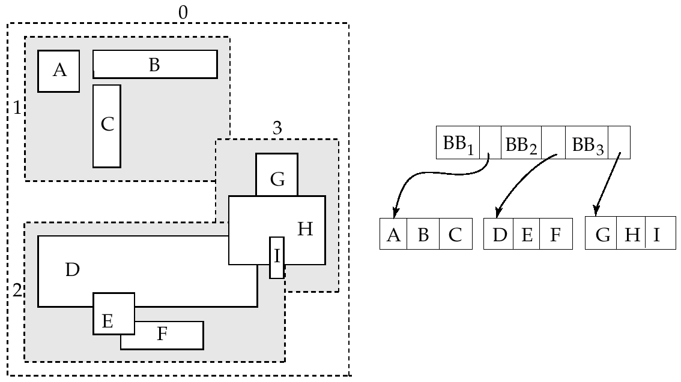
R-Trees
For spatial data (e.g. maps, rectangles, GPS data etc)

Slide 97
Conclusions
Indexing Goal: “Quickly find the tuples that match certain conditions”
Equality and range queries most common
Hence B+-Trees the predominant structure for on-disk representation
Hashing is used more commonly for in-memory operations
Many many more types of indexing structures exist
For different types of data
For different types of queries
E.g. “nearest-neighbor” queries

Slide 98
CMSC424: Database Design Module: Database Implementation
Query Processing
Instructor: Amol Deshpande
amol@cs.umd.edu

Slide 99
Database Implementation
Shifting into discussing the internals of a DBMS
How data stored? How queries/transactions executed?
Topics:
Storage: How is data stored? Important features of the storage devices (RAM, Disks, SSDs, etc)
File Organization: How are tuples mapped to blocks
Indexes: How to quickly find specific tuples of interest (e.g., all ‘friends’ of ‘user0’)
Query processing: How to execute different relational operations? How to combine them to execute an SQL query?
Query optimization: How to choose the best way to execute a query?

Slide 100
Overview and Cost Measures
Book Chapters
12.1, 12.2, 12.3, 12.4, 12.5, 12.6
Key topics:
Main steps in Query Processing
How to measure the ”cost” of an operation so we can compare alternatives?
Different types of operations

Slide 101
Query Processing/Storage
user query
results
Given an input user query, decide how to “execute” it
Specify sequence of pages to be brought in memory
Operate upon the tuples to produce results
Query Processing Engine
page requests
pointers
to pages
Bringing pages from disk to memory
Managing the limited memory
Buffer Management
block requests
data
Space Management on Persistent Storage (e.g., Disks)
Storage hierarchy
How are relations mapped to files?
How are tuples mapped to disk blocks?

Slide 102
Getting Deeper into Query Processing
User
select *
from R, S
where …
Resolve the references,
Syntax errors etc.
Converts the query to an
internal format
relational algebra like
Query Parser
Query Optimizer
Results
Find the best way to evaluate
the query
Which index to use ?
What join method to use ?
…
Query Processor
Read the data from the files
Do the query processing
joins, selections, aggregates
…
R, B+Tree on R.a
S, Hash Index on S.a
…

Slide 103
Getting Deeper into Query Processing

Slide 104
“Cost”
Complicated to compute, but very important to decide early on
Need to know what you are “optimizing” for
Many competing factors in today’s computing environment
CPU Instructions
Disk I/Os
Network Usage – either peak or average (for distributed settings)
Memory Usage
Cache Misses
… and so on
Want to pick the one (or combination) that’s actually a bottleneck
No sense in optimizing for “memory usage” if you have a TB of memory and a single disk
Can do combinations by doing a weighted sum: e.g., 10 * Memory + 50 * Disk I/Os

Slide 105
“Cost”
We will focus on counting the amount of data processed (in terms of disk blocks), and the CPU costs if appropriate
Somewhat of a simplification, but works okay
In particular, it doesn’t account for random vs sequential access, or the tuple layouts (mostly)
Textbook uses a cost function that considers random vs sequential disk I/Os

Slide 106
Selection Operation
select * from person where SSN = “123”
Option 1: Sequential Scan
Read the relation start to end and look for “123”
Can always be used (not true for the other options)
Cost ?
Data transferred = b_{person} = Number of relation blocks
CPU cost = O(N), if N is the number of tuples

Slide 107
Selection Operation
select * from person where SSN = “123”
Option 2 : Use a B+-tree Index
Pre-condition:
An appropriate index must exist
Cost:
n = the number of disk blocks containing data of interest
For a secondary index, the data of interest spread out all over the relation
h = height of the B+-tree index
Data transferred: h + n
CPU Cost: harder to calculate but comparatively lower

Slide 108
Selection Operation
Selections involving ranges
select * from accounts where balance > 100000
select * from matches where matchdate between ’10/20/06’ and ’10/30/06’
Option 1: Sequential scan
Option 2: Using an appropriate index
Can’t use hash indexes for this purpose

Slide 109
Join
select * from R, S where R.a = S.a
Called an “equi-join”
select * from R, S where |R.a – S.a | < 0.5
Not an “equi-join”
Goal: For each tuple r in R, find all “matching” tuples in S (or vice versa)
Simplest Algorithm (“nested loops” join)
for each tuple r in R
for each tuple s in S
check if r.a = s.a (or whether |r.a – s.a| < 0.5)
Complexity too high -- O(N_{r} N_{s})
e.g., imagine if |R| and |S| both in millions of tuples

Slide 110
Index Nested-loops Join
select * from R, S where R.a = S.a
Called an “equi-join”
Let’s say there is an “index” on S.a
for each tuple r in R
use the index to find S tuples with S.a = r.a
Works pretty well if the index on S is a “primary” index
Otherwise the disk I/Os may become too much

Slide 111
Index Nested-loops Join
Restricted applicability
An appropriate index must exist
What about |R.a – S.a| < 5 ?
Great for queries with joins and selections
select *
from accounts, customers
where accounts.customer-SSN = customers.customer-SSN and
accounts.acct-number = “A-101”
Only need to access one SSN from the other relation

Slide 112
Hash Join
Assume S is the smaller relation and fits in memory
read S in memory and build a hash index (hash table) on it
for each tuple r in R
use the hash index on S to find tuples such that S.a = r.a
Cost: O(N_{r} + N_{s} + O) -- where O is the number of output tuples
Why good ?
CPU cost is much better

Slide 113
Hash Join
Case 2: Smaller relation (S) doesn’t fit in memory
Two “phases”
Phase 1:
Read the relation R block by block and partition it using a hash function, h1(a)
Create one partition for each possible value of h1(a)
Write the partitions to disk
R gets partitioned into R1, R2, …, Rk
Similarly, read and partition S, and write partitions S1, S2, …, Sk to disk
Only requirement:
Each S partition fits in memory

Slide 114
Hash Join
Case 2: Smaller relation (S) doesn’t fit in memory
Two “phases”
Phase 2:
Read S1 into memory, and bulid a hash index on it (S1 fits in memory)
Using a different hash function, h₂(a)
Read R1 block by block, and use the hash index to find matches.
Repeat for S2, R2, and so on.

Slide 115
Hash Join
Case 2: Smaller relation (S) doesn’t fit in memory
Two “phases”:
Phase 1:
Partition the relations using one hash function, h₁(a)
Phase 2:
Read S_{i} into memory, and bulid a hash index on it (S_{i} fits in memory)
Read R_{i} block by block, and use the hash index to find matches.
Cost ?
We read and write the two relations thrice (instead of once)

Slide 116
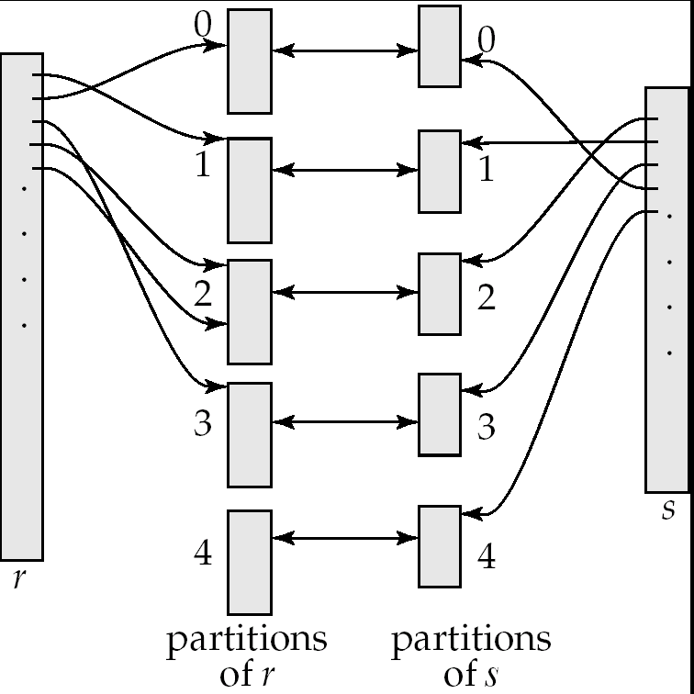
Hash Join

Slide 117
Hash Join: Issues
How to guarantee that the partitions of S all fit in memory ?
Say S = 10000 blocks, Memory = M = 100 blocks
Use a hash function that hashes to 100 different values ?
Eg. h1(a) = a % 100 ?
Problem: Impossible to guarantee uniform split
Some partitions will be larger than 100 blocks, some will be smaller
Use a hash function that hashes to 100*f different values
f is called fudge factor, typically around 1.2
So we may consider h1(a) = a % 120.
This is okay IF a is uniformly distributed
What if the hash function turns out to be bad ?
Repartition using a different hash function (at run time)

Slide 118
Sorting
Commonly required for many operations
Duplicate elimination, group by’s, sort-merge join
Queries may have ASC or DSC in the query
One option:
Read the lowest level of the index
May be enough in many cases
But if relation not sorted, this leads to too many random accesses
If relation small enough…
Read in memory, use quick sort (qsort() in C)
What if relation too large to fit in memory ?
External sort-merge

Slide 119
External sort-merge
Divide and Conquer !!
Let M denote the memory size (in blocks)
Phase 1:
Read first M blocks of relation, sort, and write it to disk
Read the next M blocks, sort, and write to disk …
Say we have to do this “N” times
Result: N sorted runs of size M blocks each
Phase 2:
Merge the N runs (N-way merge)
Can do it in one shot if N < M

Slide 120
External sort-merge
Phase 1:
Create sorted runs of size M each
Result: N sorted runs of size M blocks each
Phase 2:
Merge the N runs (N-way merge)
Can do it in one shot if N < M
What if N > M ?
Do it recursively
Not expected to happen
If M = 1000 blocks = 4MB (assuming blocks of 4KB each)
Can sort: 4000MB = 4GB of data

Slide 121
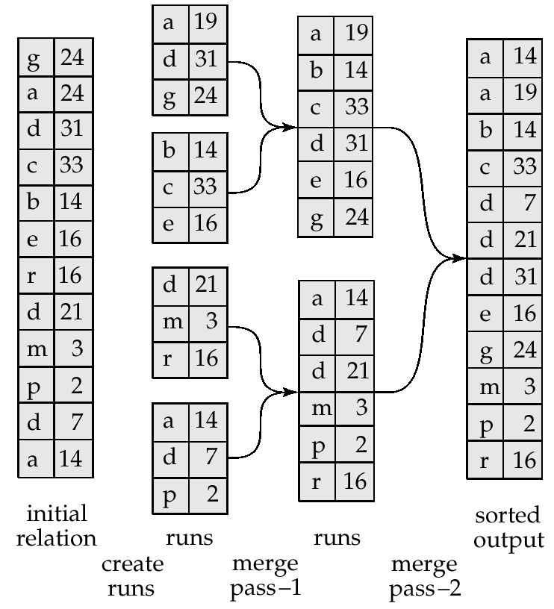
Example: External Sorting Using Sort-Merge

Slide 122
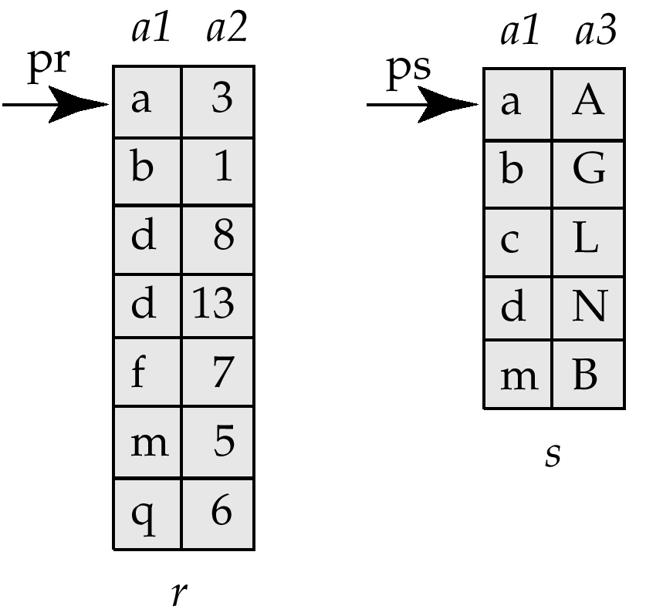
Merge-Join (Sort-merge join)
Pre-condition:
The relations must be sorted by the join attribute
If not sorted, can sort first, and then use this algorithms
Called “sort-merge join” sometimes
select *
from r, s
where r.a1 = s.a1
Step:
1. Compare the tuples at pr and ps
2. Move pointers down the list
- Depending on the join condition
3. Repeat

Slide 123
Merge-Join (Sort-merge join)
Cost:
If the relations sorted, then just
b_{r} + b_{s} block transfers, some seeks depending on memory size
What if not sorted ?
Then sort the relations first
In many cases, still very good performance
Typically comparable to hash join
Observation:
The final join result will also be sorted on a1
This might make further operations easier to do
E.g. duplicate elimination

Slide 124
Joins: Summary
Nested-loops join
Can always be applied irrespective of the join condition
Index Nested-loops join
Only applies if an appropriate index exists
Hash joins – only for equi-joins
Join algorithm of choice when the relations are large
Sort-merge join
Very commonly used – especially since relations are typically sorted
Sorted results commonly desired at the output
To answer group by queries, for duplicate elimination, because of ASC/DSC

Slide 125
Group By and Aggregation
select a, count(b)
from R
group by a;
Hash-based algorithm
Steps:
Create a hash table on a, and keep the count(b) so far
Read R tuples one by one
For a new R tuple, “r”
Check if r.a exists in the hash table
If yes, increment the count
If not, insert a new value

Slide 126
Group By and Aggregation
select a, count(b)
from R
group by a;
Sort-based algorithm
Steps:
Sort R on a
Now all tuples in a single group are contigous
Read tuples of R (sorted) one by one and compute the aggregates

Slide 127
Group By and Aggregation
select a, AGGR(b) from R group by a;
sum(), count(), min(), max(): only need to maintain one value per group
Called “distributive”
average() : need to maintain the “sum” and “count” per group
Called “algebraic”
stddev(): algebraic, but need to maintain some more state
median(): can do efficiently with sort, but need two passes (called “holistic”)
First to find the number of tuples in each group, and then to find the median tuple in each group
count(distinct b): must do duplicate elimination before the count

Slide 128
Duplicate Elimination
select distinct a
from R ;
Best done using sorting – Can also be done using hashing
Steps:
Sort the relation R
Read tuples of R in sorted order
prev = null;
for each tuple r in R (sorted)
if r != prev then
Output r
prev = r
else
Skip r

Slide 129
Set operations
(select * from R) union (select * from S) ;
(select * from R) intersect (select * from S) ;
(select * from R) union all (select * from S) ;
(select * from R) intersect all (select * from S) ;
Remember the rules about duplicates
“union all”: just append the tuples of R and S
“union”: append the tuples of R and S, and do duplicate elimination
“intersection”: similar to joins
Find tuples of R and S that are identical on all attributes
Can use hash-based or sort-based algorithm

Slide 130
Outer Joins
Say: R FULL OUTER JOIN S, on R.a = S.a
Need to keep track of which tuples of R “do not match” any tuples from S, and vice versa
Hash-based, with a hash index on S:
For a tuple r in R, if the probe returns NULL, output r padded with NULLs
For each tuple s in S, maintain a Boolean variable (in the hash table) to track whether s was returned for any probes
At the end, go through the hash table, and look for S tuples that did not match anything
Merge join can also be adapted in a similar way

Slide 131
CMSC424: Database Design Module: Query Processing
Putting it All Together
Instructor: Amol Deshpande
amol@cs.umd.edu

Slide 132
Putting it all together
Book Chapters
12.7
Key topics:
How to put it all together in a query plan
Pipelining vs Materialization
Iterator Interface

Slide 133
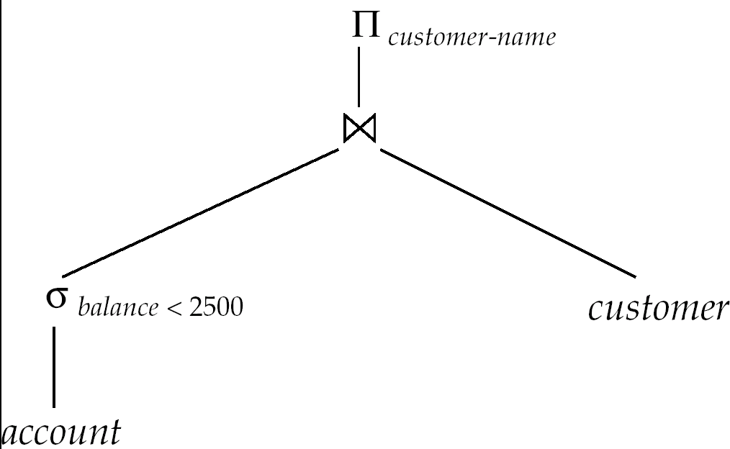
Evaluation of Expressions
select customer-name
from account a, customer c
where a.SSN = c.SSN and
a.balance < 2500
Two options:
Materialization
Pipelining

Slide 134
Evaluation of Expressions
Materialization
Evaluate each expression separately
Store its result on disk in temporary relations
Read it for next operation
Pipelining
Evaluate multiple operators simultaneously
Skip the step of going to disk
Usually faster, but requires more memory
Also not always possible..
E.g. Sort-Merge Join
Harder to reason about

Slide 135
Materialization
Materialized evaluation is always applicable
Cost of writing results to disk and reading them back can be quite high
Our cost formulas for operations ignore cost of writing results to disk, so
Overall cost = Sum of costs of individual operations + cost of writing intermediate results to disk
Double buffering: use two output buffers for each operation, when one is full write it to disk, while the other is getting filled
Allows overlap of disk writes with computation and reduces execution time

Slide 136
Pipelining
Evaluate several operations simultaneously, passing the results of one operation on to the next.
E.g., in previous expression tree, don’t store result of
instead, pass tuples directly to the join.. Similarly, don’t store result of join, pass tuples directly to projection.
Much cheaper: no need to store a temporary relation to disk.
Requires higher amount of memory
All operations are executing at the same time (say as processes)
Somewhat limited applicability
A “blocking” operation: An operation that has to consume entire input before it starts producing output tuples

Slide 137
Pipelining
Need operators that generate output tuples while receiving tuples from their inputs
Selection: Usually yes.
Sort: NO. The sort operation is blocking
Sort-merge join: The final (merge) phase can be pipelined
Hash join: The partitioning phase is blocking; the second phase can be pipelined
Aggregates: Typically no. Need to wait for the entire input before producing output
However, there are tricks you can play here
Duplicate elimination: Since it requires sort, the final merge phase could be pipelined
Set operations: see duplicate elimination

Slide 138
Recap: Query Processing
Many, many ways to implement the relational operations
Numerous more used in practice
Especially in data warehouses which handle TBs (even PBs) of data
However, consider how complex SQL is and how much you can do
Compared to that, this isn’t much
Most of it is very nicely modular
Can plug in new operators quite easily
PostgreSQL query processing codebase easy to read and modify
Having so many operators does complicate the codebase and the query optimizer though
But needed for performance

Slide 139
CMSC424: Database Design Module: Query Processing
Query Optimization
Instructor: Amol Deshpande
amol@umd.edu

Slide 140
Query Optimization: Overview
Key topics:
Why query optimization is so important?
Key steps in query optimization
High-level concepts

Slide 141
Getting Deeper into Query Processing
User
select *
from R, S
where …
Resolve the references,
Syntax errors etc.
Converts the query to an
internal format
relational algebra like
Query Parser
Query Optimizer
Results
Find the best way to evaluate
the query
Which index to use ?
What join method to use ?
…
Query Processor
Read the data from the files
Do the query processing
joins, selections, aggregates
…
R, B+Tree on R.a
S, Hash Index on S.a
…

Slide 142
Query Optimization
Why ?
Many different ways of executing a given query
Huge differences in cost
Example:
select * from person where ssn = “123”
Size of person = 1GB
Sequential Scan:
Takes 1GB / (20MB/s) = 50s
Use an index on SSN (assuming one exists):
Approx 4 Random I/Os = 40ms

Slide 143
Query Optimization
Many choices
Using indexes or not, which join method (hash, vs merge, vs NL)
What join order ?
Given a join query on R, S, T, should I join R with S first, or S with T first ?
This is an optimization problem
Similar to say traveling salesman problem
Number of different choices is very very large
Step 1: Figuring out the solution space
Step 2: Finding algorithms/heuristics to search through the solution space

Slide 144
Query Optimization: Goal
Find the best (or a good enough) execution plan
Execution plans = Evaluation expressions annotated with the methods used

Slide 145
Query Optimization
Steps:
Generate all possible execution plans for the query
Figure out the cost for each of them
Choose the best
Not done exactly as listed above
Too many different execution plans for that
Typically interleave all of these into a single efficient search algorithm

Slide 146
Equivalence of Expressions
Equivalent relational expressions
Drawn as a tree
List the operations and the order

Slide 147
Equivalence of Expressions
Two relational expressions equivalent iff:
Their result is identical on all legal databases
Equivalence rules:
Allow replacing one expression with another
Examples:
1.
2. Selections are commutative

Slide 148
Equivalence Rules
Examples:
3.
5. E_{1 θ} E₂ = E₂ _{θ} E₁
7(a). If θ₀ only involves attributes from E₁
σ_{θ0}(E₁ _{θ} E₂) = (σ_{θ0}(E₁)) _{θ} E₂
And so on…
Many rules of this type

Slide 149
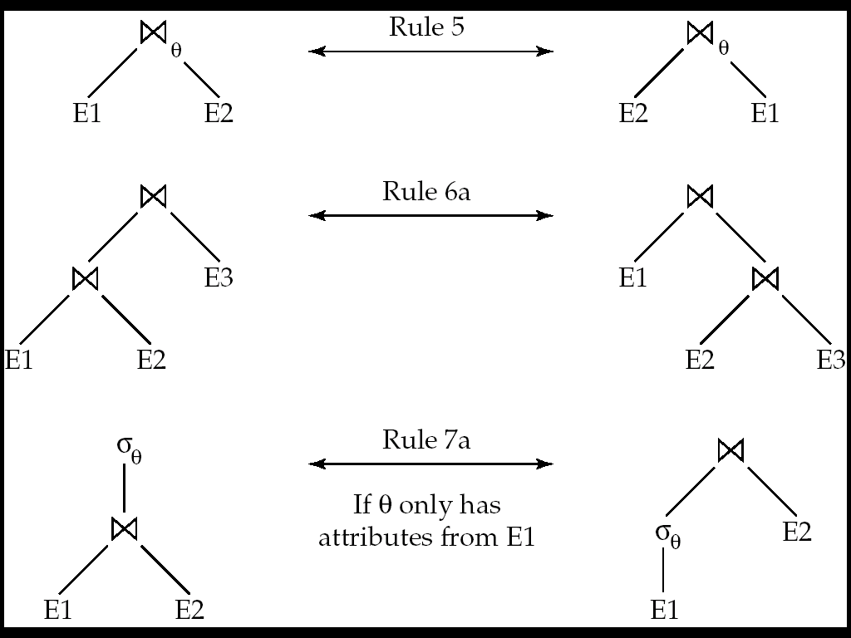
Pictorial Depiction

Slide 150
More Equivalence Rules
The set operations union and intersection are commutative and associative E₁ ∪ E₂ ≡ E₂ ∪ E₁ E₁ ∩ E₂ ≡ E₂ ∩ E₁
(E₁ ∪ E₂ ) ∪ E₃ ≡ E₁ ∪ (E₂ ∪ E₃) (E₁ ∩ E₂ ) ∩ E₃ ≡ E₁ ∩ (E₂ ∩ E₃)
But not set difference
E₁ - E₂ ≢ E₂ - E₁

Slide 151
More Equivalence Rules
Outerjoins are more involved
E₁ ⟗ E₂ ≡ E₂ ⟗ E₁
E₁ ⟕ E₂ ≡ E₂ ⟖ E₁
Outerjoins are not associative
(r ⟕ s) ⟕ t ≢ r ⟕ (s ⟕ t)
e.g. with r(A,B) = {(1,1), s(B,C) = { (1,1)}, t(A,C) = { }

Slide 152
Equivalence of Expressions
The rules give us a way to enumerate all equivalent expressions
Note that the expressions don’t contain physical access methods, join methods etc…
Simple Algorithm:
Start with the original expression
Apply all possible applicable rules to get a new set of expressions
Repeat with this new set of expressions
Till no new expressions are generated

Slide 153
Equivalence of Expressions
Works, but is not feasible
Consider a simple case:
R1 (R2 (R3 (… Rn)))….)
Just join commutativity and associativity will give us:
At least:
n^2 * 2^n
At worst:
n! * 2^n
Typically the process of enumeration is combined with the search process

Slide 154
Evaluation Plans
We still need to choose the join methods etc..
Option 1: Choose for each operation separately
Usually okay, but sometimes the operators interact
Consider joining three relations on the same attribute:
R1 _{a} (R2 _{a} R3)
Best option for R2 join R3 might be hash-join
But if R1 is sorted on a, then sort-merge join is preferable
Because it produces the result in sorted order by a
Also, we need to decide whether to use pipelining or materialization
Such issues are typically taken into account when doing the optimization

Slide 155
Query Optimization
Steps:
Generate all possible execution plans for the query
First generate all equivalent expressions
Then consider all annotations for the operations
Figure out the cost for each of them
Compute cost for each operation
Using the formulas discussed before
One problem: How do we know the number of result tuples for, say,
Add them !
Choose the best

Slide 156
Cost estimation
Computing operator costs requires information like:
Primary key ?
Sorted or not, which attribute
So we can decide whether need to sort again
How many tuples in the relation, how many blocks ?
How many tuples match a predicate like “age > 40” ?
E.g. Need to know how many index pages need to be read
Intermediate result sizes
E.g. (R JOIN S) is input to another join operation – need to know if it fits in memory
And so on…

Slide 157
Cost estimation
Some information is static and is maintained in the metadata
Primary key ?
Sorted or not, which attribute
So we can decide whether need to sort again
How many tuples in the relation, how many blocks ?
Typically kept in some tables in the database
“all_tab_columns” in Oracle
Most systems have commands for updating them

Slide 158
Cost estimation
However, others need to be estimated somehow
How many tuples match a predicate like “age > 40” ?
E.g. Need to know how many index pages need to be read
Intermediate result sizes
The problem variously called:
“intermediate result size estimation”
“selectivity estimation”
Very important to estimate reasonably well
e.g. consider “select * from R where zipcode = 20742”
We estimate that there are 10 matches, and choose to use a secondary index (remember: random I/Os)
Turns out there are 10000 matches
Using a secondary index very bad idea
Optimizer also often choose Nested-loop joins if one relation very small… underestimation can result in very bad

Slide 159
Selectivity Estimation
Basic idea:
Maintain some information about the tables
More information → more accurate estimation
More information → higher storage cost, higher update cost
Make uniformity and randomness assumptions to fill in the gaps
Example:
For a relation “people”, we keep:
Total number of tuples = 100,000
Distinct “zipcode” values that appear in it = 100
Given a query: “zipcode = 20742”
We estimated the number of matching tuples as: 100,000/100 = 1000
What if I wanted more accurate information ?
Keep better statistics/summaries…

Slide 160
Examples
Consider a range query: x < R.a < y
Let Max(a, R) = maximum value of a in R
Let Min(a, R) = minimum value of a in R
Then: fraction of tuples that satisfy = (y – x) / (Max – Min)
Assuming all tuples are distributed uniformly and randomly
If y > Max or x < Min → adjust accordingly
Better summary statistics (like histograms) can help with refining these estimates

Slide 161
Example: Joins
R JOIN S: R.a = S.a
|R| = 10,000; |S| = 5000
CASE 1: a is key for S
Each tuple of R joins with exactly one tuple of S
So: |R JOIN S| = |R| = 10,000
Assumption: Referential integrity holds
What if there is a selection on R or S
Adjust accordingly
Say: S.b = 100, with selectivity 0.1
THEN: |R JOIN S| = |R| * 0.1 = 100
CASE 2: a is key for R
Similar

Slide 162
Joins
R JOIN S: R.a = S.a
|R| = 10,000; |S| = 5000
CASE 3: a is not a key for either
Reason with the distributions on a
Say: the domain of a: V(A, R) = 100 (the number of distinct values a can take)
THEN, assuming uniformity
For each value of a
We have 10,000/100 = 100 tuples of R with that value of a
We have 5000/100 = 50 tuples of S with that value of a
All of these will join with each other, and produce 100 *50 = 5000
So total number of results in the join:
5000 * 100 = 500000
We can improve the accuracy if we know the distributions on a better
Say using a histogram

Slide 163
Query Optimization
Steps:
Generate all possible execution plans for the query
First generate all equivalent expressions
Then consider all annotations for the operations
Figure out the cost for each of them
Compute cost for each operation
Using the formulas discussed before
One problem: How do we know the number of result tuples for, say,
Add them !
Choose the best

Slide 164
Optimization Algorithms
Two types:
Exhaustive: That attempt to find the best plan
Heuristical: That are simpler, but are not guaranteed to find the optimal plan
Consider a simple case
Join of the relations R1, …, Rn
No selections, no projections
Still very large plan space

Slide 165
Searching for the best plan
Option 1:
Enumerate all equivalent expressions for the original query expression
Using the rules outlined earlier
Estimate cost for each and choose the lowest
Too expensive !
Consider finding the best join-order for r₁ r₂ . . . r_{n}.
There are (2(n – 1))!/(n – 1)! different join orders for above expression. With n = 7, the number is 665280, with n = 10, the number is greater than 176 billion!

Slide 166
Searching for the best plan
Option 2:
Dynamic programming
There is too much commonality between the plans
Also, costs are additive
Caveat: Sort orders (also called “interesting orders”)
Reduces the cost down to O(n3^n) or O(n2^n) in most cases
Interesting orders increase this a little bit
Considered acceptable
Typically n < 10.
Switch to heuristic if not acceptable

Slide 167
Heuristic Optimization
Dynamic programming is expensive
Use heuristics to reduce the number of choices
Typically rule-based:
Perform selection early (reduces the number of tuples)
Perform projection early (reduces the number of attributes)
Perform most restrictive selection and join operations before other similar operations.
Some systems use only heuristics, others combine heuristics with partial cost-based optimization.

Slide 168
Summary
Integral component of query processing
Why ?
One of the most complex pieces of code in a database system
Active area of research
E.g. MongoDB Query Optimization ?
What if you don’t know anything about the statistics
Better statistics
Etc …

Slide 169
CMSC424: Database Design Module: Implementation
Transactions Summary
Instructor: Amol Deshpande
amol@umd.edu

Slide 170
Overview
Transaction: A sequence of database actions enclosed within special tags
Properties:
Atomicity: Entire transaction or nothing
Consistency: Transaction, executed completely, takes database from one consistent state to another
Isolation: Concurrent transactions appear to run in isolation
Durability: Effects of committed transactions are not lost
Consistency: Transaction programmer needs to guarantee that
DBMS can do a few things, e.g., enforce constraints on the data
Rest: DBMS guarantees

Slide 171
Examples of Transactions
insert into students values (…)
update instructor
set salary = salary * 1.03
enrolled = select count(*)
from takes
where (course_info) = (CMSC 424, 201, Fall 2022)
if enrolled < capacity for the room:
insert new student into takes for that course
(Modify prerequisites)
delete (CMSC422, CMSC351)
insert (CMSC422, CMSC320)
(Add a new section for a course for a given room and instructor)
if no section currently in that room:
insert a tuple into “sections” with that room
insert a tuple into “teaches”
(Remove a section)
delete from takes for that section
delete from teaches for that section
delete tuple from section
(Switch the advisor for a student)
delete old tuple with that s_id
add new tuple with that s_id and new advisor

Slide 172
Examples of Transactions
enrolled = select count(*)
from takes
where (course_info) = (CMSC 424, 201, Fall 2022)
if enrolled < capacity for the room:
insert student A into takes for that course
enrolled = select count(*)
from takes
where (course_info) = (CMSC 424, 201, Fall 2022)
if enrolled < capacity for the room:
insert student B into takes for that course
What if two different students tried to enroll at the same time?
Concurrency Control

Slide 173
Examples of Transactions
update instructor
set salary = salary * 1.03
What if only part of the transaction
was completed?
(Modify prerequisites)
delete (CMSC422, CMSC351)
insert (CMSC422, CMSC320)
(Remove a section)
delete from takes for that section
delete from teaches for that section
delete tuple from section
(Switch the advisor for a student)
delete old tuple with that s_id
add new tuple with that s_id and new advisor
Recovery

Slide 174
A Schedule
Transactions:
T1: transfers $50 from A to B
T2: transfers 10% of A to B
Database constraint: A + B is constant (checking+saving accts)
T1
read(A)
A = A -50
write(A)
read(B)
B=B+50
write(B)
T2
read(A)
tmp = A*0.1
A = A – tmp
write(A)
read(B)
B = B+ tmp
write(B)
Effect: Before After
A 100 45
B 50 105
Each transaction obeys the constraint.
This schedule does too.
NOTE: This is assuming “global” writes

Slide 175
Another schedule
T1
read(A)
A = A -50
write(A)
read(B)
B=B+50
write(B)
T2
read(A)
tmp = A*0.1
A = A – tmp
write(A)
read(B)
B = B + tmp
write(B)
Is this schedule okay ?
Lets look at the final effect…
Effect: Before After
A 100 45
B 50 105
Consistent.
So this schedule is okay too.

Slide 176
Another schedule
T1
read(A)
A = A -50
write(A)
read(B)
B=B+50
write(B)
T2
read(A)
tmp = A*0.1
A = A – tmp
write(A)
read(B)
B = B+ tmp
write(B)
Is this schedule okay ?
Lets look at the final effect…
Effect: Before After
A 100 45
B 50 105
Further, the effect same as the
serial schedule 1.
Called serializable

Slide 177
Example Schedules (Cont.)
A “bad” schedule
T1
read(A)
A = A -50
write(A)
read(B)
B=B+50
write(B)
T2
read(A)
tmp = A*0.1
A = A – tmp
write(A)
read(B)
B = B+ tmp
write(B)
Effect: Before After
A 100 50
B 50 60
Not consistent

Slide 178
Example Schedules – Compute Final Result
Effect: Before After
A 100 ??
B 50 ??
T1
read(A)
A = A -50
write(A)
read(B)
B=B+50
write(B)
T2
read(A)
tmp = A*0.1
A = A – tmp
write(A)
read(B)
B = B+ tmp
write(B)
T3
read(A)
tmp = A*0.2
A = A + tmp
write(A)
read(B)
B = B - tmp
write(B)
T1
read(A)
A = A -50
write(A)
read(B)
B=B+50
write(B)
T2
read(A)
tmp = A*0.1
A = A – tmp
write(A)
read(B)
B = B+ tmp
write(B)
T3
read(A)
A = A + 20
write(A)

Slide 179
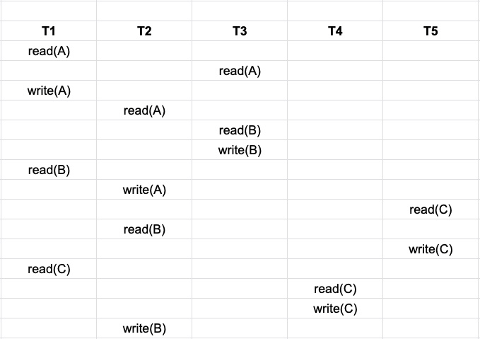
Find Serializable Schedules

Slide 180
CMSC424: Database Design Module: Implementation
Concurrency Control: Locking
Instructor: Amol Deshpande
amol@umd.edu

Slide 181
Locking - 1
Book Chapters
15.1.1-15.1.4, 15.2
Key topics:
Using locking to guarantee concurrency
2-Phase Locking (2PL)
Implementation of locking
Deadlocks

Slide 182
Lock-based Protocols
A transaction must get a lock before operating on the data
Two types of locks:
Shared (S) locks (also called read locks)
Obtained if we want to only read an item – lock-S() instruction
Exclusive (X) locks (also called write locks)
Obtained for updating a data item – lock-X() instruction
T1
T2
T1
T2
lock-X(B)
read(B)
B ←B-50
write(B)
unlock(B)
lock-X(A)
read(A)
A ←A + 50
write(A)
unlock(A)
lock-S(A)
read(A)
unlock(A)
lock-S(B)
read(B)
unlock(B)
display(A+B)
read(B)
B ←B-50
write(B)
read(A)
A ←A + 50
write(A)
read(A)
read(B)
display(A+B)

Slide 183
Lock-based Protocols
Lock requests are made to the concurrency control manager
It decides whether to grant a lock request
T1 asks for a lock on data item A, and T2 currently has a lock on it ?
Depends
If compatible, grant the lock, otherwise T1 waits in a queue.
T2 lock type | T1 lock type | Should allow ?
Shared | Shared | YES
Shared | Exclusive | NO
Exclusive | - | NO

Slide 184
Lock-based Protocols
How do we actually use this to guarantee serializability/recoverability ?
Not enough just to take locks when you need to read/write something
T1
lock-X(B)
read(B)
B ←B-50
write(B)
unlock(B)
lock-X(A)
read(A)
A ←A + 50
write(A)
unlock(A)
lock-X(A), lock-X(B)
TMP = (A + B) * 0.1
A = A - TMP
B = B + TMP
unlock(A), unlock(B)
NOT SERIALIZABLE

Slide 185
2-Phase Locking Protocol (2PL)
Phase 1: Growing phase
Transaction may obtain locks
But may not release them
Phase 2: Shrinking phase
Transaction may only release locks
Can be shown that this achieves serializability
lock-point: the time at which a transaction acquired last lock
if lock-point(T1) < lock-point(T2), there is no way for T1 to read any update of T2
T1
lock-X(B)
read(B)
B ←B-50
write(B)
unlock(B)
lock-X(A)
read(A)
A ←A + 50
write(A)
unlock(A)

Slide 186
2 Phase Locking
Example: T1 in 2PL
T1
lock-X(B) read(B) B ← B - 50 write(B) lock-X(A) read(A) A ← A - 50 write(A) unlock(B) unlock(A)
Growing phase
Shrinking phase

Slide 187
2 Phase Locking
Guarantees serializability, but not “cascade-less recoverability”
T1 | T2 | T3
lock-X(A), lock-S(B) read(A) read(B) write(A) unlock(A), unlock(B) <xction fails> | lock-X(A) read(A) write(A) unlock(A) Commit | lock-S(A) read(A) Commit

Slide 188
2 Phase Locking
Guarantees serializability, but not “cascade-less recoverability”
Guaranteeing just recoverability:
If T2 reads a dirty data of T1 (ie, T1 has not committed), then T2 can’t commit unless T1 either commits or aborts
If T1 commits, T2 can proceed with committing
If T1 aborts, T2 must abort
So cascades still happen

Slide 189
Strict 2PL
Release exclusive locks only at the very end, just after commit or abort
T1 | T2 | T3
lock-X(A), lock-S(B) read(A) read(B) write(A) unlock(A), unlock(B) <xction fails> | lock-X(A) read(A) write(A) unlock(A) Commit | lock-S(A) read(A) Commit
Strict 2PL
will not
allow that
Works. Guarantees cascade-less and recoverable schedules.

Slide 190
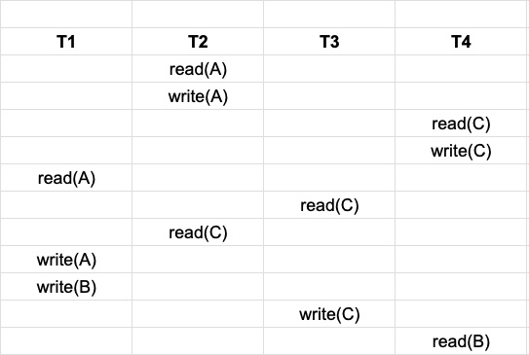
Strict 2PL - Example
Why wouldn’t this schedule be permitted under Strict 2PL?

Slide 191
Strict 2PL
Release exclusive locks only at the very end, just before commit or abort
Read locks are not important
Rigorous 2PL: Release both exclusive and read locks only at the very end
The serializability order === the commit order
More intuitive behavior for the users
No difference for the system
Lock conversion:
Transaction might not be sure what it needs a write lock on
Start with a S lock
Upgrade to an X lock later if needed
Doesn’t change any of the other properties of the protocol

Slide 192
Implementation of Locking
A separate process, or a separate module
Uses a lock table to keep track of currently assigned locks and the requests for locks

Slide 193
Lock Table
Black rectangles indicate granted locks, white ones indicate waiting requests
Lock table also records the type of lock granted or requested
New request is added to the end of the queue of requests for the data item, and granted if it is compatible with all earlier locks
Unlock requests result in the request being deleted, and later requests are checked to see if they can now be granted
If transaction aborts, all waiting or granted requests of the transaction are deleted
lock manager may keep a list of locks held by each transaction, to implement this efficiently

Slide 194
More Locking Issues: Deadlocks
No xction proceeds:
Deadlock
- T1 waits for T2 to unlock A
- T2 waits for T1 to unlock B
2PL does not prevent deadlock
Strict doesn’t either
T1 | T2
lock-X(B) read(B) B ← B-50 write(B) lock-X(A) | lock-S(A) read(A) lock-S(B)
Rollback transactions
Can be costly...

Slide 195
Deadlock detection and recovery
Instead of trying to prevent deadlocks, let them happen and deal with them if they happen
How do you detect a deadlock?
Wait-for graph
Directed edge from Ti to Tj
Ti waiting for Tj
T2
T4
T1
T3
T1 | T2 | T3 | T4
S(V) | X(V) S(W) | X(Z) S(V) | X(W)
Suppose T4 requests lock-S(Z)....

Slide 196
Dealing with Deadlocks
Deadlock detected, now what ?
Will need to abort some transaction
Prefer to abort the one with the minimum work done so far
Possibility of starvation
If a transaction is aborted too many times, it may be given priority in continueing

Slide 197
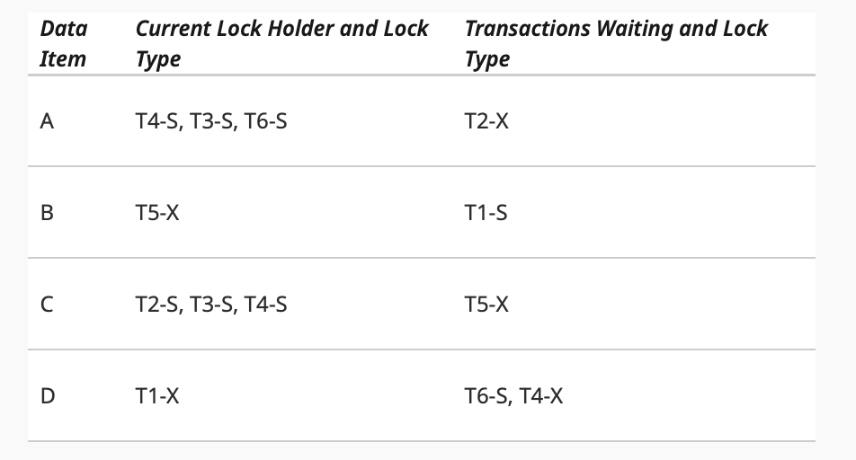
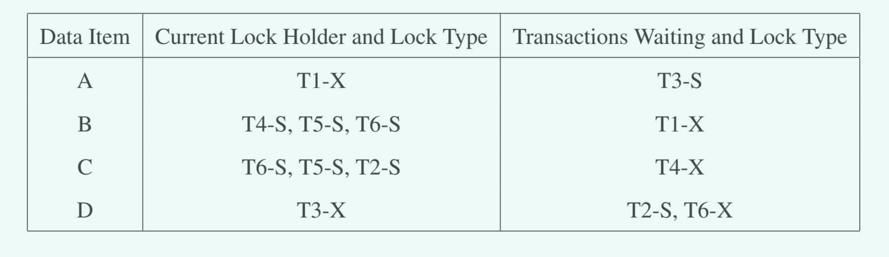
Deadlocks -- Example
Is there a deadlock here? How to resolve it?

Slide 198
Preventing deadlocks
Solution 1: A transaction must acquire all locks before it begins
Not acceptable in most cases
Still need some way to deal with deadlocks during lock acquisition
Solution 2: A transaction must acquire locks in a particular order over the data items
Also called graph-based protocols
The particular order used doesn’t matter (e.g., based on the value of some unique attribute)
Guarantees that there can never be a cycle in the precedence graph

Slide 199
Preventing deadlocks
Solution 3: Use time-stamps; say T1 is older than T2
wait-die scheme: T1 will wait for T2. T2 will not wait for T1; instead it will abort and restart
In the precedence graph, there can be an edge from old transaction to a new transaction, but never the other way
So there cannot be a cycle in precedence graph
wound-wait scheme: T1 will wound T2 (force it to abort) if it needs a lock that T2 currently has; T2 will wait for T1.
Similar to above: edges only from newer transactions to older transactions
May abort more transactions that needed
Solution 4: Timeout based
Transaction waits a certain time for a lock; aborts if it doesn’t get it by then
As above, may lead to unnecessary restarts, but very simple to implement

Slide 200
CMSC424: Database Design Module: Transactions and ACID Properties
Concurrency Control:
Other Schemes
Instructor: Amol Deshpande
amol@umd.edu

Slide 201
1. Time-stamp Based
Time-stamp based
Transactions are issued time-stamps when they enter the system
The time-stamps determine the serializability order
So if T1 entered before T2, then T1 should be before T2 in the serializability order
Say timestamp(T1) < timestamp(T2)
If T1 wants to read data item A
If any transaction with larger time-stamp wrote that data item, then this operation is not permitted, and T1 is aborted
If T1 wants to write data item A
If a transaction with larger time-stamp already read that data item or written it, then the write is rejected and T1 is aborted
Aborted transaction are restarted with a new timestamp
Possibility of starvation

Slide 202
1. Time-stamp Based
Maintain for each data Q, two timestamps:
W-timestamp(Q): largest time-stamp of any transaction that executed Write(Q) successfully
R-timestamp(Q): largest time-stamp of any transaction that executed Read(Q) successfully
Suppose Ti wants to read(Q):
If TS(T_i) < W-Timestamp(Q): Reject the operation and roll back T_i
Otherwise, allow the operation and modify:
R-timestamp(Q) = max(R-timestamp(Q)), TS(T_i))

Slide 203
1. Time-stamp Based
Maintain for each data Q, two timestamps:
W-timestamp(Q): largest time-stamp of any transaction that executed Write(Q) successfully
R-timestamp(Q): largest time-stamp of any transaction that executed Read(Q) successfully
Suppose Ti wants to write(Q):
1. If TS(T_{i}) < R-timestamp(Q): reject the write and roll back T_i
2. If TS(T_{i}) < W-timestamp(Q), then T_{i} is attempting to write an
obsolete value of Q.
Hence, this write operation is rejected, and T_{i} is rolled back.
3. Otherwise, execute write, and W-timestamp(Q) is set to TS(T_{i}).

Slide 204
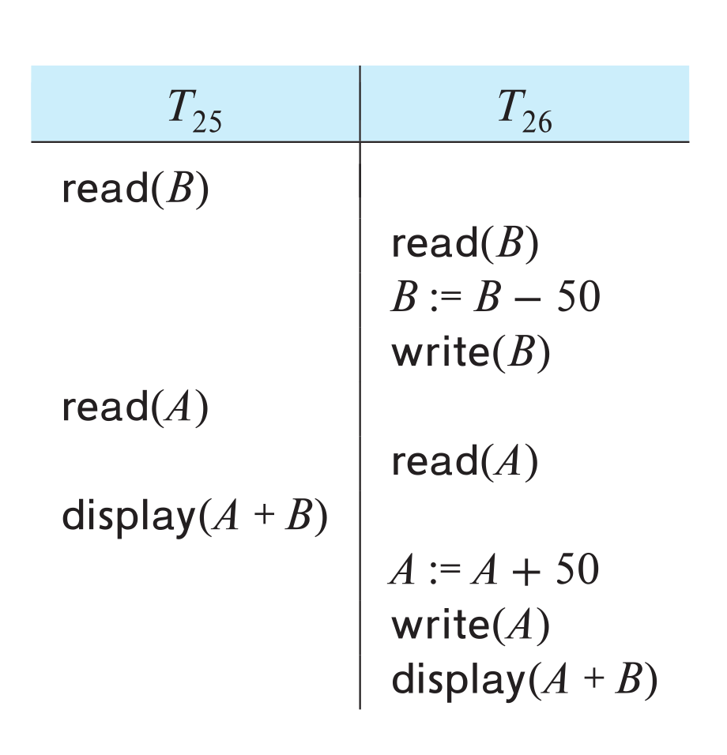
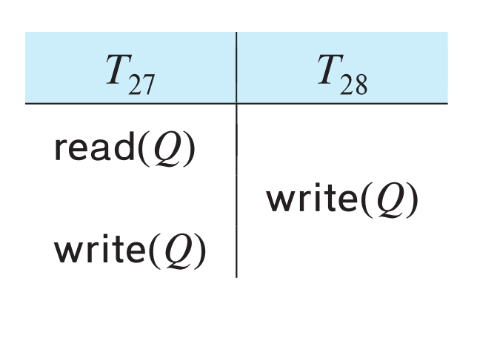
1. Example of Schedule Under TSO
Is this schedule valid under TSO?
Assume that initially:
R-TS(A) = W-TS(A) = 0
R-TS(B) = W-TS(B) = 0
Assume TS(T₂₅) = 25 and TS(T₂₆) = 26
How about this one, where initially R-TS(Q)=W-TS(Q)=0

Slide 205
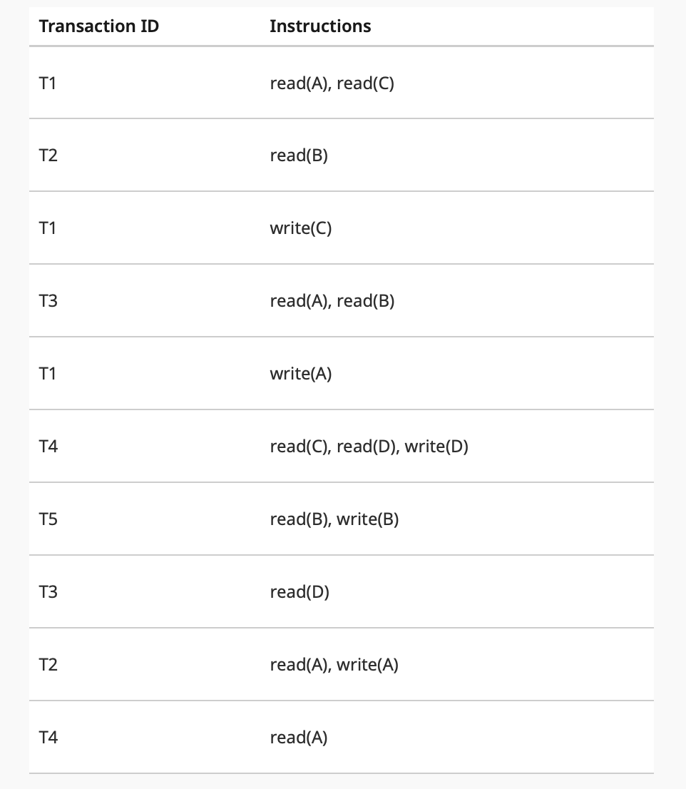
Example (1)
Consider 5 transactions with timestamp order: T1, T2, T3, T4, T5 (i.e., T1 was the first transaction, etc).
Which transactions would be forced to abort? Answer for each one independently.

Slide 206
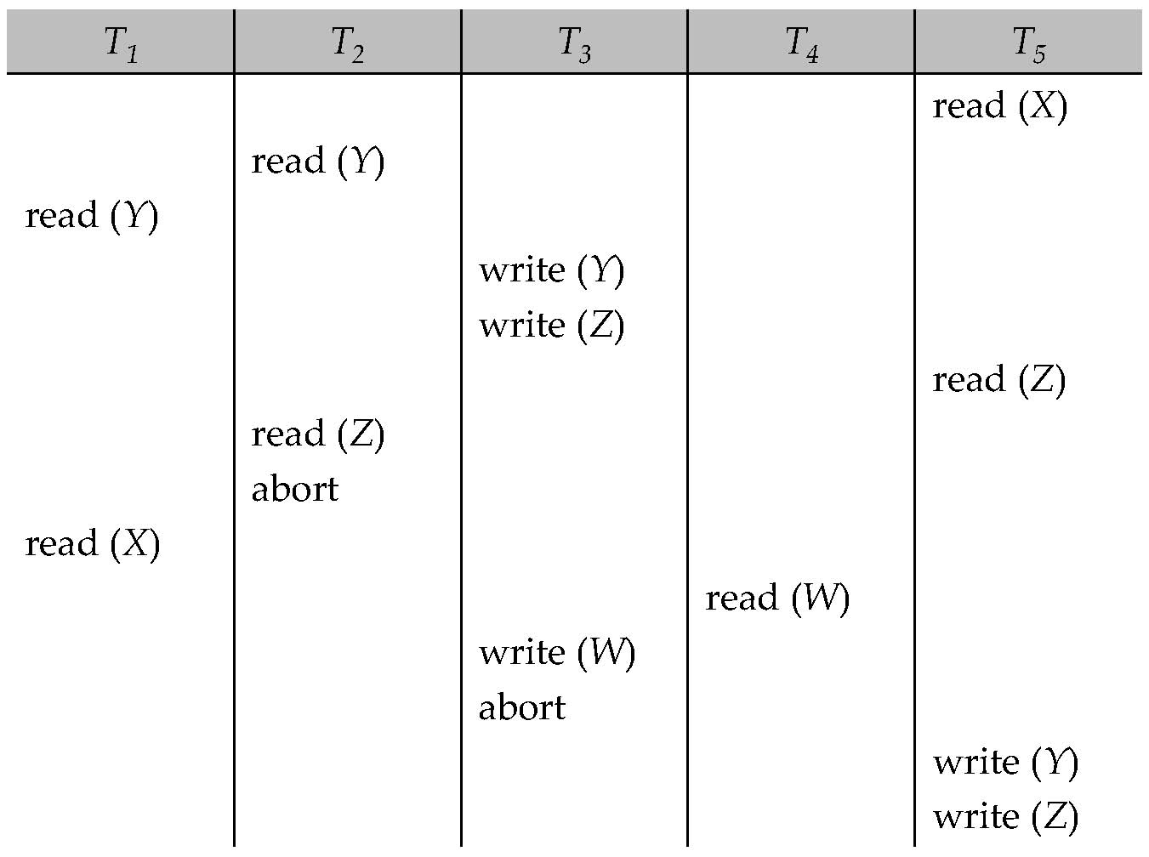
1. Another Example
Example

Slide 207
2. Optimistic Concurrency Control
Optimistic concurrency control
Also called validation-based
Intuition
Let the transactions execute as they wish
At the very end when they are about to commit, check if there might be any problems/conflicts etc
If no, let it commit
If yes, abort and restart
Optimistic: The hope is that there won’t be too many problems/aborts

Slide 208
2. Optimistic Concurrency Control
Each transaction T_{i} has 3 timestamps
Start(T_{i}) : the time when T_{i} started its execution
Validation(T_{i}): the time when T_{i} entered its validation phase
Finish(T_{i}) : the time when T_{i} finished its write phase
Serializability order is determined by timestamp given at validation time, to increase concurrency.
Thus TS(T_{i}) is given the value of Validation(T_{i}).
This protocol is useful and gives greater degree of concurrency if probability of conflicts is low.
because the serializability order is not pre-decided, and
relatively few transactions will have to be rolled back.

Slide 209
2. Optimistic Concurrency Control
If for all T_{i} with TS (T_{i}) < TS (T_{j}) either one of the following condition holds:
finish(T_{i}) < start(T_{j})
start(T_{j}) < finish(T_{i}) < validation(T_{j}) and the set of data items written by T_{i} does not intersect with the set of data items read by T_{j}.
then validation succeeds and T_{j} can be committed. Otherwise, validation fails and T_{j} is aborted.
Justification: Either the first condition is satisfied, and there is no overlapped execution, or the second condition is satisfied and
the writes of T_{j} do not affect reads of T_{i} since they occur after T_{i} has finished its reads.
the writes of T_{i} do not affect reads of T_{j} since T_{j} does not read any item written by T_{i}.

Slide 210
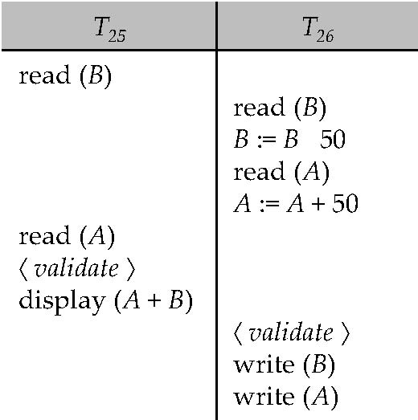
2. Optimistic Concurrency Control
Example of schedule produced using validation

Slide 211
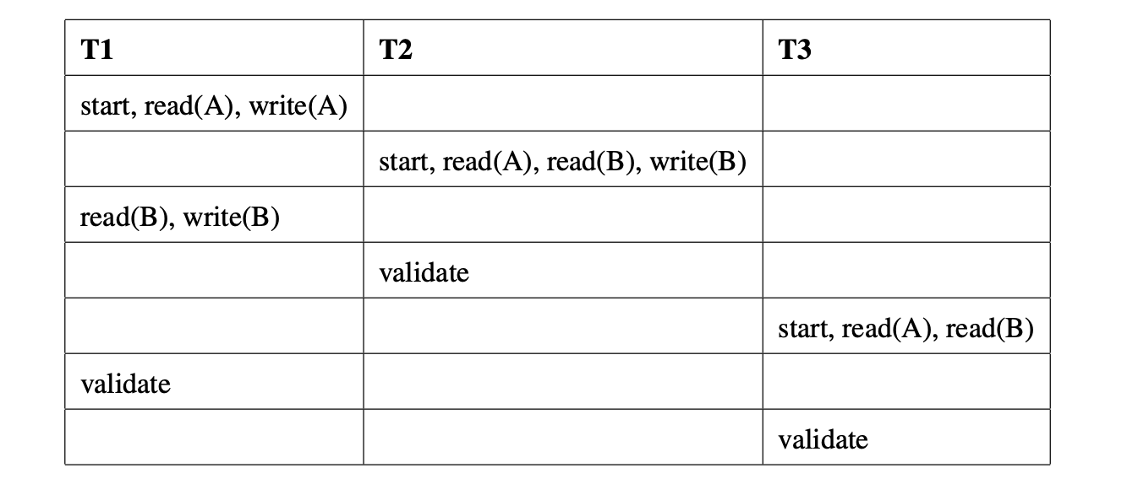
Example (2)
Explain what checks would be made in each of the validation steps (in order), and whether the validation step succeeds or fails (assume the decisions made for the earlier validate steps, if any, hold).

Slide 212
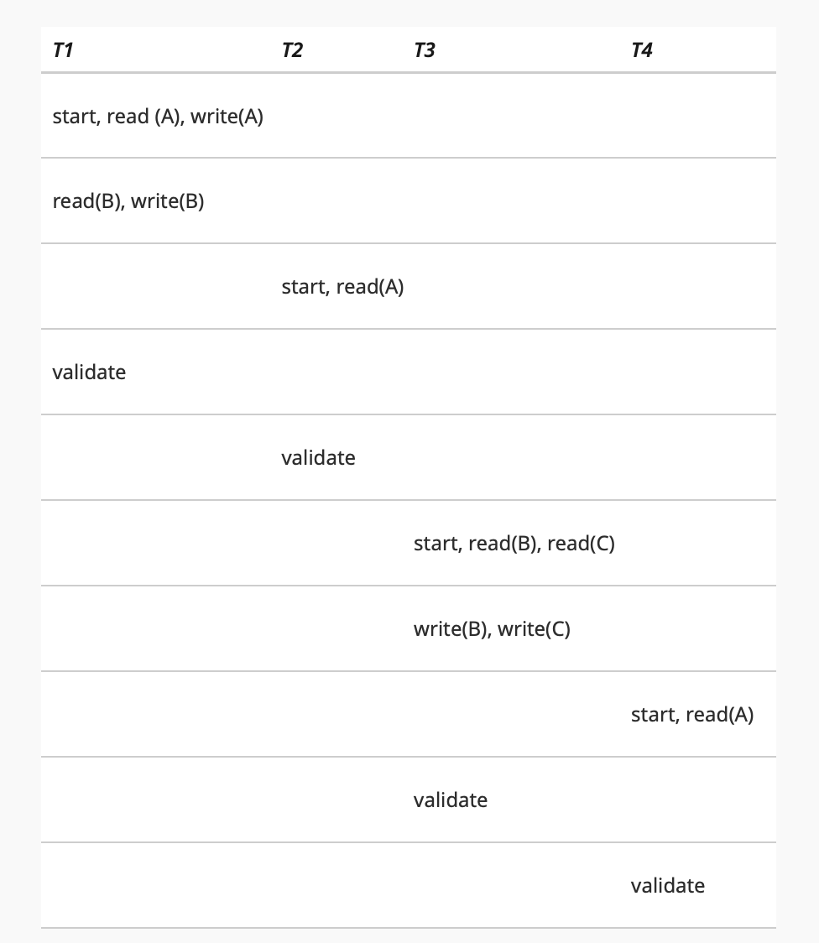
Example (3)
Which of the transactions will successfully pass the validation?
Answer for each transaction in isolation -- i.e., assume all other transactions are successful (and finish at the same time as validate) when deciding whether any specific transaction will validate or not.

Slide 213
3. Snapshot Isolation
Very popular scheme, used as the primary scheme by many systems including Oracle, PostgreSQL etc…
Several others support this in addition to locking-based protocol
A type of “multi-version concurrency control”
Also similar to optimistic concurrency control in many ways
Key idea:
For each object, maintain past “versions” of the data along with timestamps
Every update to an object causes a new version to be generated

Slide 214
3. Snapshot Isolation
Read queries:
Let “t” be the “time-stamp” of the query, i.e., the time at which it entered the system
When the query asks for a data item, provide a version of the data item that was latest as of “t”
Even if the data changed in between, provide an old version
No locks needed, no waiting for any other transactions or queries
The query executes on a consistent snapshot of the database
Update queries (transactions):
Reads processed as above on a snapshot
Writes are done in private storage
At commit time, for each object that was written, check if some other transaction updated the data item since this transaction started
If yes, then abort and restart
If no, make all the writes public simultaneously (by making new versions)

Slide 215
3. Snapshot Isolation
A transaction T1 executing with Snapshot Isolation
takes snapshot of committed data at start
always reads/modifies data in its own snapshot
updates of concurrent transactions are not visible to T1
writes of T1 complete when it commits
First-committer-wins rule:
Commits only if no other concurrent transaction has already written data that T1 intends to write.
T1 | T2 | T3
W(Y := 1) Commit
 | Start R(X) → 0 R(Y)→ 1
 |  | W(X:=2) W(Z:=3) Commit
 | R(Z) → 0 R(Y) → 1 W(X:=3) Commit-Req Abort
Concurrent updates not visible
Own updates are visible
Not first-committer of X
Serialization error, T2 is rolled back

Slide 216
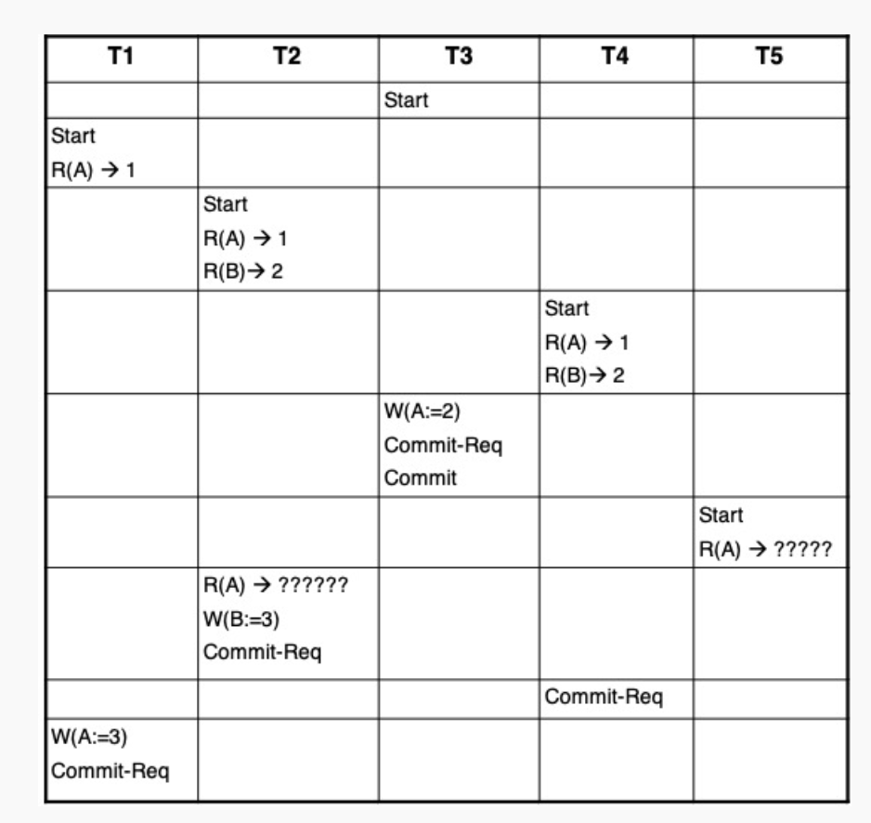
Example (4)
What values of "A" would T2 and T5 read? See the "??????" for the specific instructions.
Of the three transactions T1, T2, and T4, that have made a Commit-Req, which ones will be allowed to commit?

Slide 217
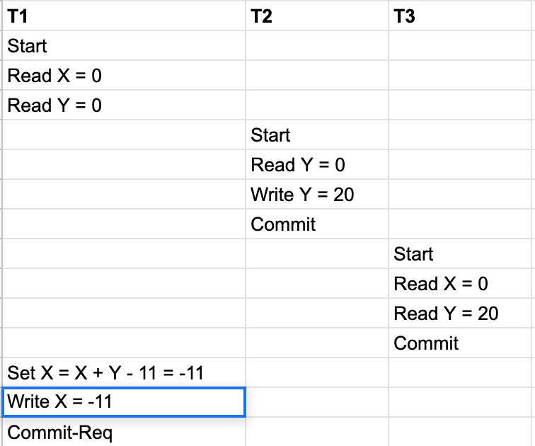
Example (5)
T2 commits successfully as there is no transaction that has committed since T2 started, and T3 commits successfully as it is a read-only transaction.
Would T1 be allowed to commit?
Is this schedule serializable? Clearly explain why or why not.

Slide 218
3. Snapshot Isolation
Advantages:
Read query don’t block at all, and run very fast
As long as conflicts are rare, update transactions don’t abort either
Overall better performance than locking-based protocols
Major disadvantage:
Not serializable
Inconsistencies may be introduced
See the wikipedia article for more details and an example
http://en.wikipedia.org/wiki/Snapshot_isolation

Slide 219
3. Snapshot Isolation
Example of problem with SI
T1: x:=y
T2: y:= x
Initially x = 3 and y = 17
Serial execution: x = ??, y = ??
if both transactions start at the same time, with snapshot isolation: x = ?? , y = ??
Called skew write
Skew also occurs with inserts
E.g:
Find max order number among all orders
Create a new order with order number = previous max + 1

Slide 220
3. SI In Oracle and PostgreSQL
Warning: SI used when isolation level is set to serializable, by Oracle, and PostgreSQL versions prior to 9.1
PostgreSQL’s implementation of SI (versions prior to 9.1) described in Section 26.4.1.3
Oracle implements “first updater wins” rule (variant of “first committer wins”)
concurrent writer check is done at time of write, not at commit time
Allows transactions to be rolled back earlier
Oracle and PostgreSQL < 9.1 do not support true serializable execution
PostgreSQL 9.1 introduced new protocol called “Serializable Snapshot Isolation” (SSI)
Which guarantees true serializabilty including handling predicate reads (coming up)

Slide 221
CMSC424: Database Design Module: Transactions and ACID Properties
Recovery: Overview; Terminology; Steal and Force
Instructor: Amol Deshpande
amol@umd.edu

Slide 222
Transactions: Recovery
Book Chapters
16.1, 16.2, 16.3.2
Key topics:
Challenges in guaranteeing Atomicity and Durability
Basics of how disks and memory interact
New operations: Output() and Input()
STEAL and NO FORCE: Why those are desirable
Terminology used in the book: Immediate vs Deferred Modifications

Slide 223
Context
ACID properties:
We have talked about Isolation and Consistency
How do we guarantee Atomicity and Durability ?
Atomicity: Two problems
Part of the transaction is done, but we want to cancel it
ABORT/ROLLBACK
System crashes during the transaction. Some changes made it to the disk, some didn’t.
Durability:
Transaction finished. User notified. But changes not sent to disk yet (for performance reasons). System crashed.
Essentially similar solutions

Slide 224
Reasons for crashes
Transaction failures
Logical errors: transaction cannot complete due to some internal error condition
System errors: the database system must terminate an active transaction due to an error condition (e.g., deadlock)
System crash
Power failures, operating system bugs etc
Fail-stop assumption: non-volatile storage contents are assumed to not be corrupted by system crash
Database systems have numerous integrity checks to prevent corruption of disk data
Disk failure
Head crashes; for now we will assume
STABLE STORAGE: Data never lost. Can approximate by using RAID and maintaining geographically distant copies of the data

Slide 225
Approach, Assumptions etc..
Approach:
Guarantee A and D:
by controlling how the disk and memory interact,
by storing enough information during normal processing to recover from failures
by developing algorithms to recover the database state
Assumptions:
System may crash, but the disk is durable
The only atomicity guarantee is that a disk block write is atomic
Once again, obvious naïve solutions exist that work, but that are too expensive.
E.g. The shadow copy solution
Make a copy of the database; do the changes on the copy; do an atomic switch of the dbpointer at commit time
Goal is to do this as efficiently as possible

Slide 226
Data Access
Physical blocks are those blocks residing on the disk.
Buffer blocks are the blocks residing temporarily in main memory.
Block movements between disk and main memory are initiated through the following two operations:
input(B) transfers the physical block B to main memory.
output(B) transfers the buffer block B to the disk, and replaces the appropriate physical block there.
We assume, for simplicity, that each data item fits in, and is stored inside, a single block.

Slide 227
Example of Data Access
buffer
Buffer Block A
input(A)
X
A
Buffer Block B
Y
B
output(B)
read(X)
write(Y)
x₂
x₁
y₁
work area
of T₁
work area
of T₂
memory
disk

Slide 228
Data Access (Cont.)
Each transaction T_{i} has its private work-area in which local copies of all data items accessed and updated by it are kept.
T_{i}'s local copy of a data item X is called x_{i}.
Transferring data items between system buffer blocks and its private work-area done by:
read(X) assigns the value of data item X to the local variable x_{i}.
write(X) assigns the value of local variable x_{i} to data item {X} in the buffer block.
Note: output(B_{X}) need not immediately follow write(X). System can perform the output operation when it deems fit.
Transactions
Must perform read(X) before accessing X for the first time (subsequent reads can be from local copy)
write(X) can be executed at any time before the transaction commits

Slide 229
STEAL vs NO STEAL, FORCE vs NO FORCE
STEAL:
The buffer manager can steal a (memory) page from the database
ie., it can write an arbitrary page to the disk and use that page for something else from the disk
In other words, the database system doesn’t control the buffer replacement policy
Why a problem ?
The page might contain dirty writes, ie., writes/updates by a transaction that hasn’t committed
But, we must allow steal for performance reasons.
NO STEAL:
Not allowed. More control, but less flexibility for the buffer manager.

Slide 230
STEAL vs NO STEAL, FORCE vs NO FORCE
FORCE:
The database system forces all the updates of a transaction to disk before committing
Why ?
To make its updates permanent before committing
Why a problem ?
Most probably random I/Os, so poor response time and throughput
Interferes with the disk controlling policies
NO FORCE:
Don’t do the above. Desired.
Problem:
Guaranteeing durability becomes hard
We might still have to force some pages to disk, but minimal.

Slide 231
STEAL vs NO STEAL, FORCE vs NO FORCE: Recovery implications
Desired
No Force
Trivial
Force
No Steal
Steal

Slide 232
STEAL vs NO STEAL, FORCE vs NO FORCE: Recovery implications
How to implement A and D when No Steal and Force ?
Only updates from committed transaction are written to disk (since no steal)
Updates from a transaction are forced to disk before commit (since force)
A minor problem: how do you guarantee that all updates from a transaction make it to the disk atomically ?
Remember we are only guaranteed an atomic block write
What if some updates make it to disk, and other don’t ?
Can use something like shadow copying/shadow paging
No atomicity/durability problem arise.

Slide 233
Terminology
Deferred Database Modification:
Similar to NO STEAL, NO FORCE
Not identical
Only need redos, no undos
We won’t cover this in detail
Immediate Database Modification:
Similar to STEAL, NO FORCE
Need both redos, and undos

Slide 234
CMSC424: Database Design Module: Transactions and ACID Properties
Recovery: Basics of Logging and UNDO
Instructor: Amol Deshpande
amol@umd.edu

Slide 235
Transactions: Recovery
Book Chapters
16.3.1, 16.3.5
Key topics:
Generating log records
Using log records to support UNDO/Rollback

Slide 236
Log-based Recovery
Most commonly used recovery method
Intuitively, a log is a record of everything the database system does
For every operation done by the database, a log record is generated and stored typically on a different (log) disk
<T1, START>
<T2, COMMIT>
<T2, ABORT>
<T1, A, 100, 200>
T1 modified A; old value = 100, new value = 200

Slide 237
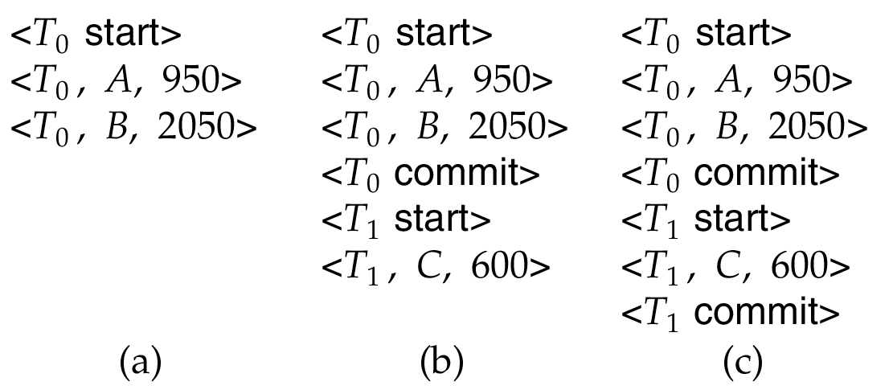
Log
Example transactionsT₀ and T₁ (T₀ executes before T₁):
T₀: read (A) T₁ : read (C)
A: - A - 50 C:- C- 100
write (A) write (C)
read (B)
B:- B + 50
write (B)
Log:

Slide 238
Log-based Recovery
Assumptions:
Log records are immediately pushed to the disk as soon as they are generated
Log records are written to disk in the order generated
A log record is generated before the actual data value is updated
Strict two-phase locking
The first assumption can be relaxed
As a special case, a transaction is considered committed only after the <T1, COMMIT> has been pushed to the disk
But, this seems like exactly what we are trying to avoid ??
Log writes are sequential
They are also typically on a different disk
Aside: LFS == log-structured file system

Slide 239
Log-based Recovery
Assumptions:
Log records are immediately pushed to the disk as soon as they are generated
Log records are written to disk in the order generated
A log record is generated before the actual data value is updated
Strict two-phase locking
The first assumption can be relaxed
As a special case, a transaction is considered committed only after the <T1, COMMIT> has been pushed to the disk
NOTE: As a result of assumptions 1 and 2, if data item A is updated, the log record corresponding to the update is always forced to the disk before data item A is written to the disk
This is actually the only property we need; assumption 1 can be relaxed to just guarantee this (called write-ahead logging)

Slide 240
Using the log to abort/rollback
STEAL is allowed, so changes of a transaction may have made it to the disk
UNDO(T1):
Procedure executed to rollback/undo the effects of a transaction
E.g.
<T1, START>
<T1, A, 200, 300>
<T1, B, 400, 300>
<T1, A, 300, 200> [[ note: second update of A ]]
T1 decides to abort
Any of the changes might have made it to the disk

Slide 241
Using the log to abort/rollback
UNDO(T1):
Go backwards in the log looking for log records belonging to T1
Restore the values to the old values
NOTE: Going backwards is important.
A was updated twice
In the example, we simply:
Restore A to 300
Restore B to 400
Restore A to 200
Write a log record <T_{i} , X_{j}, V₁>
such log records are called compensation log records
<T1, A, 300>, <T1, B, 400>, <T1, A, 200>
Note: No other transaction better have changed A or B in the meantime
Strict two-phase locking

Slide 242
CMSC424: Database Design Module: Transactions and ACID Properties
Recovery: Log-based Restart Recovery
Instructor: Amol Deshpande
amol@umd.edu

Slide 243
Using Logs for Recovery
Book Chapters
16.4
Key topics:
How to use logs for REDO
Idempotency of log records
Restart recovery after a failure

Slide 244
Using the log to recover
We don’t require FORCE, so a change made by the committed transaction may not have made it to the disk before the system crashed
BUT, the log record did (recall our assumptions)
REDO(T1):
Procedure executed to recover a committed transaction
E.g.
<T1, START>
<T1, A, 200, 300>
<T1, B, 400, 300>
<T1, A, 300, 200> [[ note: second update of A ]]
<T1, COMMIT>
By our assumptions, all the log records made it to the disk (since the transaction committed)
But any or none of the changes to A or B might have made it to disk

Slide 245
Using the log to recover
REDO(T1):
Go forwards in the log looking for log records belonging to T1
Set the values to the new values
NOTE: Going forwards is important.
In the example, we simply:
Set A to 300
Set B to 300
Set A to 200

Slide 246
Idempotency
Both redo and undo are required to idempotent
F is idempotent, if F(x) = F(F(x)) = F(F(F(F(…F(x)))))
Multiple applications shouldn’t change the effect
This is important because we don’t know exactly what made it to the disk, and we can’t keep track of that
E.g. consider a log record of the type
<T1, A, incremented by 100>
Old value was 200, and so new value was 300
But the on disk value might be 200 or 300 (since we have no control over the buffer manager)
So we have no idea whether to apply this log record or not
Hence, value based logging is used (also called physical), not operation based (also called logical)

Slide 247
Log-based recovery
Log is maintained
If during the normal processing, a transaction needs to abort
UNDO() is used for that purpose
If the system crashes, then we need to do recovery using both UNDO() and REDO()
Some transactions that were going on at the time of crash may not have completed, and must be aborted/undone
Some transaction may have committed, but their changes didn’t make it to disk, so they must be redone
Called restart recovery

Slide 248
Recovery Algorithm (Cont.)
Recovery from failure: Two phases
Redo phase: replay updates of all transactions, whether they committed, aborted, or are incomplete
Undo phase: undo all incomplete transactions
Redo phase:
Set undo-list to {} (empty).
Scan forward from first log record
Whenever a record <T_{i}, X_{j}, V₁, V₂> is found, redo it by writing V₂ to X_{j}
Whenever a log record <T_{i} start> is found, add T_{i} to undo-list
Whenever a log record <T_{i} commit> or <T_{i} abort> is found, remove T_{i} from undo-list

Slide 249
Recovery Algorithm (Cont.)
Undo phase:
Scan log backwards from end
Whenever a log record <T_{i}, X_{j}, V₁, V₂> is found where T_{i} is in undo-list perform same actions as for transaction rollback:
perform undo by writing V₁ to X_{j}.
write a log record <T_{i} , X_{j}, V₁>
Whenever a log record <T_{i} start> is found where T_{i} is in undo-list,
Write a log record <T_{i} abort>
Remove T_{i} from undo-list
Stop when undo-list is empty
i.e. <T_{i} start> has been found for every transaction in undo-list
After undo phase completes, normal transaction processing can commence

Slide 250
Example of Recovery

Slide 251
CMSC424: Database Design Module: Transactions and ACID Properties
Checkpointing; Write-ahead Logging; Recap
Instructor: Amol Deshpande
amol@umd.edu

Slide 252
Recovery: Recap
Book Chapters
16.3.6, 16.5
Key topics:
Checkpointing
Write-ahead logging
Recap

Slide 253
Checkpointing
How far should we go back in the log while constructing redo and undo lists ??
It is possible that a transaction made an update at the very beginning of the system, and that update never made it to disk
very very unlikely, but possible (because we don’t do force)
For correctness, we have to go back all the way to the beginning of the log
Bad idea !!
Checkpointing is a mechanism to reduce this

Slide 254
Checkpointing
Periodically, the database system writes out everything in the memory to disk
Goal is to get the database in a state that we know (not necessarily consistent state)
Steps:
Stop all other activity in the database system
Write out the entire contents of the memory to the disk
Only need to write updated pages, so not so bad
Entire === all updates, whether committed or not
Write out all the log records to the disk
Write out a special log record to disk
<CHECKPOINT LIST_OF_ACTIVE_TRANSACTIONS>
The second component is the list of all active transactions in the system right now
Continue with the transactions again

Slide 255
Recovery Algorithm (Cont.)
Recovery from failure: Two phases
Redo phase: replay updates of all transactions, whether they committed, aborted, or are incomplete
Undo phase: undo all incomplete transactions
Redo phase (No difference for Undo phase):
Find last <checkpoint L> record, and set undo-list to L.
- If no checkpoint record, start at the beginning
Scan forward from above <checkpoint L> record
Whenever a record <T_{i}, X_{j}, V₁, V₂> is found, redo it by writing V₂ to X_{j}
Whenever a log record <T_{i} start> is found, add T_{i} to undo-list
Whenever a log record <T_{i} commit> or <T_{i} abort> is found, remove T_{i} from undo-list

Slide 256
Recap so far …
Log-based recovery
Uses a log to aid during recovery
UNDO()
Used for normal transaction abort/rollback, as well as during restart recovery
REDO()
Used during restart recovery
Checkpoints
Used to reduce the restart recovery time

Slide 257
Write-ahead logging
We assumed that log records are written to disk as soon as generated
Too restrictive
Write-ahead logging:
Before an update on a data item (say A) makes it to disk, the log records referring to the update must be forced to disk
How ?
Each log record has a log sequence number (LSN)
Monotonically increasing
For each page in the memory, we maintain the LSN of the last log record that updated a record on this page
pageLSN
If a page P is to be written to disk, all the log records till pageLSN(P) are forced to disk

Slide 258
Write-ahead logging
Write-ahead logging (WAL) is sufficient for all our purposes
All the algorithms discussed before work
Note the special case:
A transaction is not considered committed, unless the <T, commit> record is on disk

Slide 259
Other issues
The system halts during checkpointing
Not acceptable
Advanced recovery techniques allow the system to continue processing while checkpointing is going on
System may crash during recovery
Our simple protocol is actually fine
In general, this can be painful to handle
B+-Tree and other indexing techniques
Strict 2PL is typically not followed (we didn’t cover this)
So physical logging is not sufficient; must have logical logging

Slide 260
Other issues
ARIES: Considered the canonical description of log-based recovery
Used in most systems
Has many other types of log records that simplify recovery significantly
Loss of disk:
Can use a scheme similar to checkpoining to periodically dump the database onto tapes or optical storage
Techniques exist for doing this while the transactions are executing (called fuzzy dumps)
Shadow paging:
Read up

Slide 261
Recap
STEAL vs NO STEAL, FORCE vs NO FORCE
We studied how to do STEAL and NO FORCE through log-based recovery scheme
Desired
REDO
NO UNDO
REDO
UNDO
No Force
No Force
Trivial
NO REDO
NO UNDO
NO REDO
UNDO
Force
Force
No Steal
Steal
No Steal
Steal

Slide 262
Recap
ACID Properties
Atomicity and Durability :
Logs, undo(), redo(), WAL etc
Consistency and Isolation:
Concurrency schemes
Strong interactions:
We had to assume Strict 2PL for proving correctness of recovery

Slide 263
CMSC424: Database Design Module: Transactions and ACID Properties
Distributed Transactions
Instructor: Amol Deshpande
amol@umd.edu

Slide 264
Distributed Transactions
Book Chapters
19.1-19.4, 19.6: at a fairly high level
Key topics:
Distributed databases and replication
Transaction processing in distributed databases
2-Phase Commit
Brief discussion of other protocols including Paxos

Slide 265
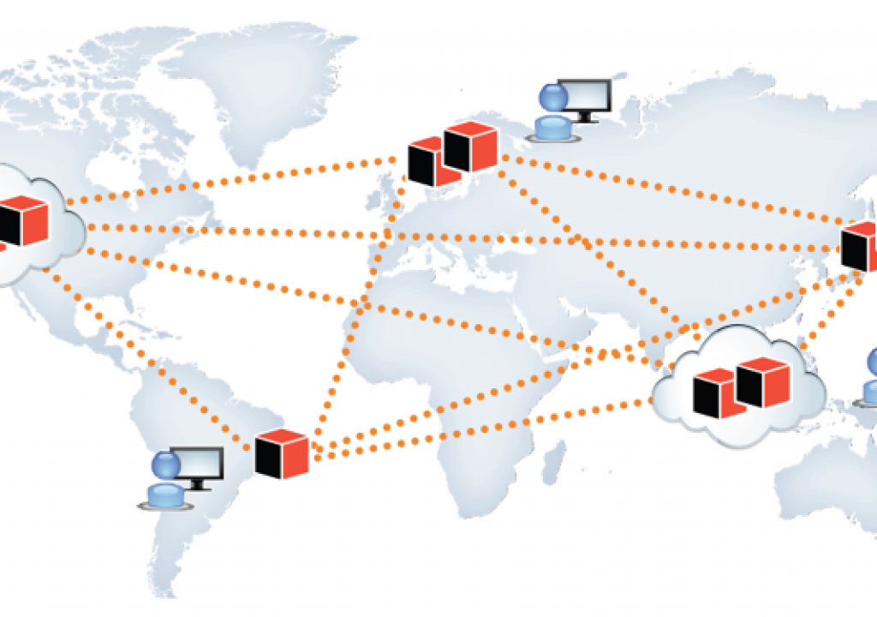
Distributed Database System
A distributed database system consists of loosely coupled sites that share no physical component
Database systems that run on each site are independent of each other
Or not – lot of variations here
Transactions may access data at one or more sites
Because of replication, even updating a single data item involves a “distributed transaction” (to keep all replicas up to date)

Slide 266
Data Replication
A relation or fragment of a relation is replicated if it is stored redundantly in two or more sites
Advantages:
Availability: failures can be handled through replicas
Parallelism: queries can be run on any replica
Reduced data transfer: queries can go to the “closest” replica
Disadvantages:
Increased cost of updates: both computation as well as latency
Increased complexity of concurrency control: need to update all copies of a data item/tuple
Typically we use the term “data items”, which may be tuples or relations or relation partitions

Slide 267
Distributed Transactions
Transaction may access data at several sites
As noted, single data item update is also a distributed transaction
Each site has a local transaction manager responsible for:
Maintaining a log for recovery purposes
Coordinating the concurrent execution of the transactions
Each site has a transaction coordinator, which is responsible for:
Starting the execution of transactions that originate at the site.
Distributing sub-transactions at appropriate sites for execution.
Coordinating the termination of each transaction that originates at the site -- transaction may commit at all sites or abort at all sites.

Slide 268
System Failure Modes
Failures unique to distributed systems:
Failure of a site.
Loss of massages
Handled by network transmission control protocols such as TCP-IP
Failure of a communication link
Handled by network protocols, by routing messages via alternative links
Network partition
A network is said to be partitioned when it has been split into two or more subsystems that lack any connection between them
Note: a subsystem may consist of a single node
Network partitioning and site failures are generally indistinguishable.

Slide 269
Commit Protocols
Commit protocols are used to ensure atomicity across sites
a transaction which executes at multiple sites must either be committed at all the sites, or aborted at all the sites.
not acceptable to have a transaction committed at one site and aborted at another
Two-phase commit (2PC) protocol is widely used
Three-phase commit (3PC) protocol
Handles some situations that 2PC doesn’t
Not widely used
Paxos
Robust alternative to 2PC that handles more situations as well
Was considered too expensive at one point, but widely used today
RAFT: Alternative to Paxos

Slide 270
Two Phase Commit Protocol (2PC)
Assumes fail-stop model – failed sites simply stop working, and do not cause any other harm, such as sending incorrect messages to other sites.
Execution of the protocol is initiated by the coordinator after the last step of the transaction has been reached.
The protocol involves all the local sites at which the transaction executed
Let T be a transaction initiated at site S_{i}, and let the transaction coordinator at S_{i} be C_{i}

Slide 271
Two Phase Commit Protocol (2PC)
Goal: Make sure all ”sites” commit or abort
Assumption: Some log records can be “forced” (denote * above)

Slide 272
Phase 1: Obtaining a Decision
Coordinator asks all participants to prepare to commit transaction T_{i}.
C_{i} adds the records <prepare T> to the log and forces log to stable storage
sends prepare T messages to all sites at which T executed
Upon receiving message, transaction manager at site determines if it can commit the transaction
if not, add a record <no T> to the log and send abort T message to C_{i}
if the transaction can be committed, then:
add the record <ready T> to the log
force all records for T to stable storage
send ready T message to C_{i}

Slide 273
Phase 2: Recording the Decision
T can be committed of C_{i} received a ready T message from all the participating sites: otherwise T must be aborted.
Coordinator adds a decision record, <commit T> or <abort T>, to the log and forces record onto stable storage. Once the record stable storage it is irrevocable (even if failures occur)
Coordinator sends a message to each participant informing it of the decision (commit or abort)
Participants take appropriate action locally.

Slide 274
Handling of Failures - Site Failure
When site S_{i} recovers, it examines its log to determine the fate of
transactions active at the time of the failure.
Log contain <commit T> record: txn had completed, nothing to be done
Log contains <abort T> record: txn had completed, nothing to be done
Log contains <ready T> record: site must consult C_{i} to determine the fate of T.
If T committed, redo (T); write <commit T> record
If T aborted, undo (T)
The log contains no log records concerning T:
Implies that S_{k} failed before responding to the prepare T message from C_{i}
since the failure of S_{k} precludes the sending of such a response, coordinator C₁ must abort T
S_{k} must execute undo (T)

Slide 275
Handling of Failures- Coordinator Failure
If coordinator fails while the commit protocol for T is executing then participating sites must decide on T’s fate:
If an active site contains a <commit T> record in its log, then T must be committed.
If an active site contains an <abort T> record in its log, then T must be aborted.
If some active participating site does not contain a <ready T> record in its log, then the failed coordinator C_{i} cannot have decided to commit T.
Can therefore abort T; however, such a site must reject any subsequent <prepare T> message from C_{i}
If none of the above cases holds, then all active sites must have a <ready T> record in their logs, but no additional control records (such as <abort T> of <commit T>).
In this case active sites must wait for C_{i} to recover, to find decision.
Blocking problem: active sites may have to wait for failed coordinator to recover.

Slide 276
Handling of Failures - Network Partition
If the coordinator and all its participants remain in one partition, the failure has no effect on the commit protocol.
If the coordinator and its participants belong to several partitions:
Sites that are not in the partition containing the coordinator think the coordinator has failed, and execute the protocol to deal with failure of the coordinator.
No harm results, but sites may still have to wait for decision from coordinator.
The coordinator and the sites are in the same partition as the coordinator think that the sites in the other partition have failed, and follow the usual commit protocol.
Again, no harm results

Slide 277
More…
Three-phase Commit
2PC can’t handle failure of a coordinator well – everything halts waiting for the coordinator to come back up
Three-phase commit handles that through another phase
Paxos and RAFT
Solutions for the “consensus problem”: get a collection of distributed entities to ”choose” a single value
In case of transaction, you are choosing abort/commit
Fairly complex, but well-understood today
Widely used in most distributed systems today
See the Wikipedia pages
A nice recent paper: Paxos vs Raft: Have we reached consensus on distributed consensus? – Heidi Howard, 2020

Slide 278
More…
Bitcoin (and other cryptocurrencies)
Fundamental problem is the same one, of obtaining “consensus”
But need to support a large number of entities, 1000s or more
Can’t assume full one-to-one communication
Instead:
Choose a “leader” based on ”proof of work”
Whoever solves a hard puzzle first becomes the “leader”
The ”leader” chooses the next “block” in the blockchain
A block is basically a list of transactions to accept
Reward the puzzle solvers with money (“bitcoins”)
So they have an incentive to keep solving puzzles
Blockchain?
Blockchain is a small part of bitcoin
A cryptographically designed chain of blocks that are immutable

